Slide 1

Vulvodynia: A Common and Under-Recognized Pain Disorder in Women and Female Adolescents
Integrating Current Knowledge Into Clinical Practice

Slide 2
Learning Objectives
At the end of this session, learners will be able to:
Recognize vulvodynia as a prevalent, misdiagnosed, and under-researched chronic pain disorder affecting millions of women and adolescent girls
Define vulvodynia and its subtypes
Summarize what is known about the pathophysiology of vulvodynia
Identify the infectious, inflammatory, neoplastic and neurologic
disorders that need to be ruled out in order to make a diagnosis of vulvodynia
Perform a comprehensive exam to diagnose the condition
Implement an individualized, multidisciplinary treatment regimen

Slide 3

Historical Perspective
Section #: Title
Contents • Contents
Early Descriptions • Current Definition

Slide 4
EARLY DESCRIPTIONS OF VULVODYNIA
1888
1928
1929-1974
1975
1880
“Hyperaesthesia of the Vulva”
Thomas described as “excessive sensibility of the nerves supplying the mucous membrane of some portion of the vulva, sometimes... confined to the vestibule... other times to one labium minus.”
Thomas 1880
Historical Perspective
Notes:
What we now refer to as “vulvodynia” was first documented in medical texts in 1880, although some believe that the condition may have been described as far back as the 1st century (McElhiney 2006). Vulvodynia was described as “supersensitiveness of the vulva” and “a fruitful source of dyspareunia,” before mention of the condition disappeared from medical texts for 5 decades.

Slide 5
EARLY DESCRIPTIONS OF VULVODYNIA
1880
1928
1929-1974
1975
1888
“Supersensitiveness of the Vulva”
Skene: “This disease...is characterized by the supersensitiveness of the vulva...No redness or other external manifestation of the disease is visible...When the examining finger comes in contact with the
hyperaesthetic part, the patient complains of pain, which is sometimes so great as to cause her to cry out. Sexual intercourse is equally painful and becomes, in aggravated cases, impossible.”
Skene 1888
Historical Perspective

Slide 6
EARLY DESCRIPTIONS OF VULVODYNIA
1880 1888
1929-1974
1975
1928
“Sensitive Deep Red Spots”
Kelly described “exquisitely sensitive deep- red spots in the mucosa of the hymenal ring as a fruitful source of dyspareunia.”
Kelly 1928
Historical Perspective

Slide 7
EARLY DESCRIPTIONS OF VULVODYNIA
1880 1888
1928
1975
1929-1974
No mention of the condition in medical texts for 5 decades.
Historical Perspective

Slide 8
EARLY DESCRIPTIONS OF VULVODYNIA
1880 1888
1928
1929-1974
1975
“Burning Vulva Syndrome”
Vulvodynia is defined as burning vulva syndrome by the International Society for the Study of Vulvovaginal Disease (ISSVD) at 1975 World Congress.
McKay 1984, Moyal-Barracco 2004, Haefner 2007
Historical Perspective

Slide 9
CURRENT DEFINITION
The current ISSVD definition of vulvodynia is:
Vulvar pain of at least 3 months duration, without a clear
identifiable cause, which may have potential associated factors.
Diagnosis of exclusion
Idiopathic pain disorder
  Bornstein 2016
Historical Perspective

Slide 10
Magnitude of the Problem
Prevalence • Incidence • Remission
Misdiagnosis • Economic impact • Quality of life

Slide 11
PREVALENCE & INCIDENCE
Prevalence
Four independent NIH-funded
population-based studies, three of which included a clinical confirmation component, demonstrate a point
prevalence of 3-7% in reproductive-aged women (Harlow 2003, Arnold 2007, Reed
2004, Reed 2006). Approximately 7% of American women will have symptoms consistent with vulvodynia by age 40, which significantly differ by ethnicity (Harlow 2014).
Vulvodynia has been documented in preadolescent girls (Reed 2008). A study of adolescent girls aged 12-19 suggests that the condition is quite prevalent among young women (Landry 2009).
Incidence
Annual incidence is 3.1% in one study (Reed 2012). More recently, the incidence was 4.2 cases per 100 woman- years and differed by age, ethnicity and marital status (Reed 2014).
Magnitude of the Problem

Slide 12
REMISSION RATES
Remission
History of any remission ranges from 26 to 38%, depending on duration of pain (Nguyen 2015). In other population-based studies, remission ranged from 17-25%, with a rate of remission incidence of 22% over two years (Reed/Haefner 2008, Reed 2012).
Magnitude of the Problem

Slide 13
AFFECTED POPULATIONS
Affected Populations
All ages affected, although the incidence of symptom onset appears highest between ages 18 to 25 (Harlow 2003, Reed 2012, Harlow 2014)
All ethnicities affected, although Hispanic women have an increased risk (Harlow 2003, Reed 2012, Harlow 2014, Reed 2014) and different
subtypes (Nguyen 2015).
Magnitude of the Problem
Notes:
Studies of women found that the incidence of symptom onset is highest between the ages of 18 and 25. Once thought to affect primarily white women, recent studies indicate that Hispanic women are significantly more likely to develop vulvodynia, and may present with different vulvar pain subtypes.

Slide 14
MISDIAGNOSIS & ECONOMIC IMPACT
Misdiagnosis is Common
2003: First NIH-funded population-based study (Harlow 2003)
• 60% of women consulted at least 3 doctors in seeking a diagnosis; 40% of them
remained undiagnosed after 3 medical consultations.
2012: Recent NIH-funded population-based study (Reed 2012)
• Only 1.4% of women seeking medical care were accurately diagnosed.
Significant Economic Impact
US direct/indirect cost is $31-$72 billion (Xie 2012).
Magnitude of the Problem
Notes:
Because vulvodynia is rarely covered in medical school curricula and residency programs, symptoms mimic those of common vulvovaginal infections, and in many cases, no abnormalities of the vulvar tissue can be seen upon examination, women are often misdiagnosed. In 2003, the first federally funded population-based epidemiologic study in Boston found that almost 60% of patients reported visiting three or more health care providers to receive a diagnosis, 40% of whom remained undiagnosed after 3 consultations.
Using prevalence estimates of three to seven percent, Xie and colleagues demonstrated the significant economic impact of vulvodynia in the U.S. of $31 to $72 billion in direct and indirect costs.

Slide 15

QUALITY OF LIFE
This graphic summarizes common themes experienced by women with vulvodynia and their interrelation (Donaldson 2010). Living with vulvodynia often limits certain activities of daily living, such as sitting
for extended periods, and engaging in
sexual intercourse and physical exercise.
In severe cases, women have to resign from their jobs and apply for disability.
Confusion About Onset of Pain
Deleterious
Consequences on Physical, Emotional
and Sexual Health and Relationships
Fruitless
Search for Causal Attributions
Self-Management Attempts with
Various Strategies Provide Little Relief
Several studies summarize the negative biopsychosocial outcomes, personal
distress and sexual dysfunction reported by vulvodynia sufferers.
Delay in Treatment for Serious Health
Condition
Numerous Barriers to Seeking Medical Care and Help
Magnitude of the Problem

Slide 16
QUALITY OF LIFE
Xie found that women with vulvodynia report lower quality of life scores than kidney transplant recipients and those with prior osteoporosis-related fractures (Xie 2012). Newly diagnosed women report substantial impact of vulvar pain on their lives, and little control over their symptoms (Piper 2012). Among women of reproductive age, Johnson found that barriers to consistent health carefrequently experienced in early adulthood contributed to not finding successful medical management (Johnson 2015).
However, those who became pregnant
reported finding a personally acceptable level of pain (Johnson 2015). Stigma and isolation are common. Only 1 in 4 women report feeling comfortable discussing the condition with women friends (Nguyen/ MacLehose 2012). They also report an
increase in feelings of invalidation and isolation when they have co-existing pain disorders (Nguyen/Ecklund 2012).
Magnitude of the Problem

Slide 17

Anatomy and Neurobiology of the Urogenital Tract
Vulva and Vulvar Vestibule • Innervation of the Vulva
Pelvic Floor Musculature

Slide 18
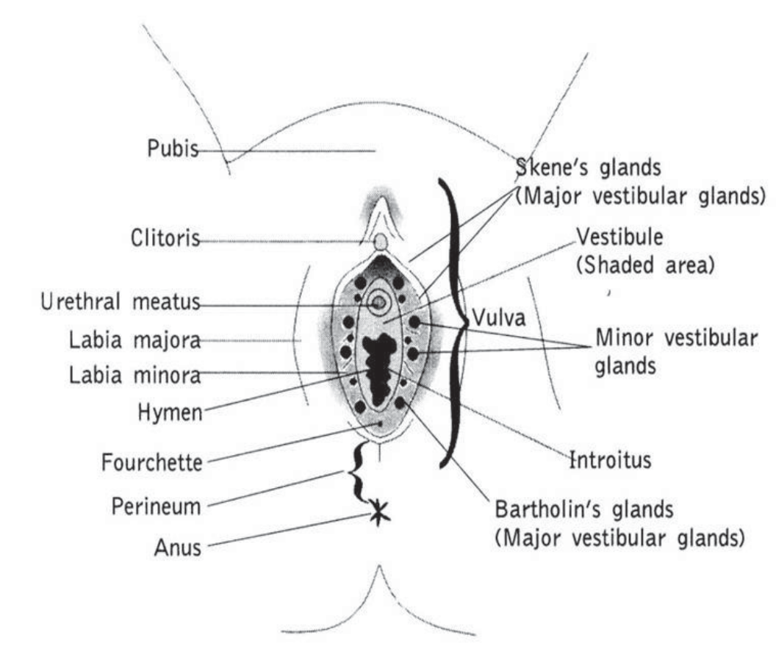
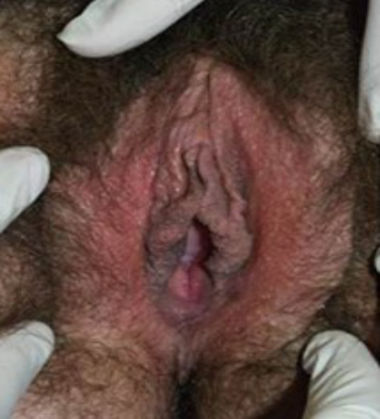
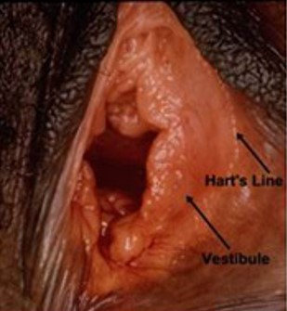
VULVA AND VULVAR VESTIBULE
Vulva
Prepuce
Image courtesy of Dr. Libby Edwards.
Vestibule
Reprinted with permission from Glazer HI and Rodke G, The Vulvodynia Survival Guide, New Harbinger Publications, 2002
For a thorough review on vulvar anatomy and physiology, see Farage 2006.
Reprinted with permission from the John O. L. DeLancey, MD collection
Anatomy & Neurobiology of the Urogenital Tract
Notes:
The vulva is the external female genitalia. It includes the mons pubis, labia majora, labia minora, prepuce or clitoral hood, clitoris, and vulvar vestibule. The vulva is the center of a woman’s sexual response. The anterior and posterior boundaries of the vulva extend from the mons pubis to the anus, respectively. Its lateral boundaries lie at the genito-crural folds. The mons pubis is comprised of a fat pad at the anterior of the vulva and is covered in pubic hair. The labia majora are derived embryologically from labioscrotal swellings. They fuse posteriorly and attach anteriorly to the mons pubis. The labia minora, hairless folds of skin embryologically derived from urethral folds, lie within the labia majora. The labia minora fuse anteriorly, forming the prepuce (hood) of the clitoris, and extend posteriorly to either side of the vaginal opening. They fuse posteriorly at the vulvar vestibule, creating a fold of skin called the posterior fourchette. The mons pubis, perineum, and labia are derived from the embryonic ectoderm. Vulvar skin is a keratinized, stratified, squamous epithelial structure that contains sebaceous glands and sweat glands. The keratin thickness of vulvar skin decreases progressively from the labia majora, over the clitoris to the labia minora. The vulvar vestibule extends from the frenulum of the clitoris anteriorly to the fourchette posteriorly. Hart’s line marks the juncture of nonkeratinized epithelium of the vestibule and the keratinized epithelium of the inner surface of the labia minora. The vulvar vestibule, derived from the urogenital sinus endoderm, contains the major vestibular glands (Bartholin’s and Skene’s) and the minor vestibular glands. The vestibular glands secrete mucous during sexual arousal and orgasm. The clitoris is located under the prepuce and is embryologically derived from the genital tubercle. It is formed of erectile corpora cavernosa tissue, which becomes engorged with blood during sexual stimulation (Farage 2006; Krantz 1977; Woodruff 1985).

Slide 19
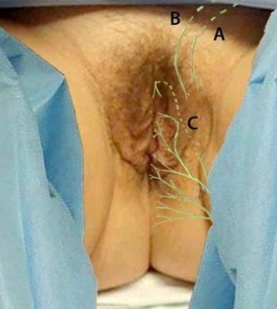
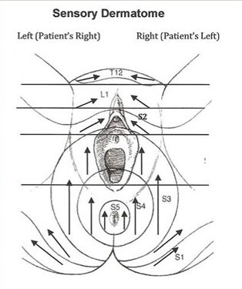
INNERVATION OF THE VULVA
D
E
Farage 2012
Images courtesy of Drs. Denniz Zolnoun and Georgine Lamvu
Anatomy & Neurobiology of the Urogenital Tract
Notes:
The vulva is innervated by the anterior labial branches of the (A) ilioinguinal nerve (L1); (B) genitofemoral nerve (L1-2); and (C, D) branches of the pudendal nerve (S2-4). Near the medial aspect of the ischial tuberosity, the pudendal nerve divides into 3 branches: (C) the dorsal nerve of the clitoris (shown deeper as dashed lines in muscles of the urogenital diaphragm), (D) the perineal nerve, which innervates the labia majora and perineum, and (E) the inferior rectal nerve, which innervates the perianal area. The pudendal nerve also innervates the external anal sphincter and deep muscles of the urogenital triangle (Peng 2009). For a thorough review of the neurobiology of the urogenital tract, see Wesselmann 1997.

Slide 20
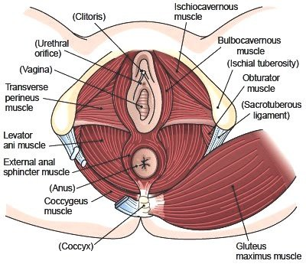
PELVIC FLOOR MUSCULATURE
Anatomy & Neurobiology of the Urogenital Tract
20
Notes:
The pelvic floor muscles are divided into 3 categories. The superficial pelvic floor muscles (bulbocavernosus or bulbospongiosus, ischiocavernosus, superficial transverse perineal/perineus muscle) are collectively known as the urogenital diaphragm. The function of the urogenital diaphragm muscles includes a role in sexual function, eg, clitoral engorgement, vaginal closure, reflexive response to enhance sexual pleasure, and facilitating closure of the urethra and anus for continence. The middle layer is comprised of the deep transverse perineal muscle and sphincter urethra. The deep pelvic floor muscles, sometimes called the anal triangle, include the levator ani (pubococcygeus, iliococcygeus, and puborectalis), and coccygeus. Other associated pelvic and hip muscles include the piriformis, obturator internus muscles, and gluteus maximus. The perineal body is the central tendon and attachment site for the superficial, middle, and deep pelvic floor muscles.
The internal pudendal artery, vein, and nerve, which pass through Alcock’s canal, provide neurovascular function to the pelvic floor musculature. Alcock’s canal is comprised of fascia or connective tissue from the obturator internus. Although the pudendal nerve is known to innervate the levator ani muscles there have been more recent studies describing innervation by the levator ani nerve and direct nerve roots S3 and/or S4 (Barber 2002, Grigorescu 2008). Specifically, the pubococcygeus muscle is innervated by the levator ani nerve S3-5 and the perineal branch of the pudendal nerve S3-4. The iliococcygeus is innervated by the levator ani nerve S3-4 and the puborectalis is innervated by the inferior rectal branches of the pudendal nerve S2-S4. The coccygeus is innervated by direct nerve roots S3-4. The function of the deep pelvic floor muscles includes supporting the abdominal viscera or organs, providing pelvic and spinal stability, assisting in respiration, and providing sphincteric closure for bowel and bladder function. They also play a role in sexual function. For a thorough review of the anatomy and physiology of the pelvic floor, see Herschorn 2004.

Slide 21
Terminology and Classification
ISSVD Classification: Vulvar Pain and Vulvodynia
Other Terms

Slide 22
ISSVD CLASSIFICATION: VULVAR PAIN
Vulvar pain related to a specific disorder, i.e., NOT vulvodynia
Infectious (recurrent candidiasis, herpes)
Inflammatory (lichen sclerosus, lichen planus, immunobullous disorders)
Neoplastic (Paget’s disease, squamous cell carcinoma)
Neurologic (post-herpetic neuralgia, nerve compression or injury, neuroma)
Trauma (female genital cutting, obstetrical)
Iatrogenic (post-operative, chemotherapy, radiation)
Hormonal deficiencies (genito-urinary syndrome of menopause, lactational amenorrhea)
                Bornstein 2016
Terminology and Classification
Notes:
The current classification differentiates: vulvar pain due to a known cause vs. idiopathic chronic vulvar pain (ie, vulvodynia).

Slide 23
ISSVD CLASSIFICATION: VULVODYNIA
Vulvodynia is vulvar pain of at least 3 months duration, without a clear identifiable cause, which may have potential associated factors*.
Descriptors:
Generalized (multiple areas of the vulva involved), localized (one area of the vulva involved, e.g., clitorodynia, hemi-vulvodynia) or mixed (localized and generalized)
Provoked (insertional, contact), spontaneous or mixed (provoked and spontaneous)
- Provoked pain local to the vestibule: “provoked vestibulodynia” (previously vulvar
vestibulitis syndrome)
Onset (primary or secondary)
Temporal pattern (intermittent, persistent, constant, immediate, or delayed)
Terminology and Classification
Notes:
Pain is first classified by location , ie, generalized (several areas of the vulva), localized (a specific area of the vulva) or mixed; secondly, it is classified by provocation (provoked, spontaneous or mixed). It is also described by onset (either primary or secondary) and temporal pattern (intermittent, persistent, constant, immediate, or delayed). The 2 most common forms of vulvodynia are: generalized vulvodynia and provoked vestibulodynia (formerly vulvar vestibulitis syndrome). It should be noted that women may have both a specific disorder (eg, lichen sclerosus) and vulvodynia. Please see Slide 26 for potential associated factors.

Slide 24
OTHER TERMS - CONFUSION IS COMMON
Generalized Provoked Vulvodynia Vestibulodynia
Hyperaesthesia of the vulva Dysesthetic Vulvodynia Vulvar Dysesthesia Essential Vulvodynia | Vulvar Vestibulitis Syndrome Vestibular Adenitis Minor Vestibular Gland Syndrome Localized Provoked Vulvodynia
Terminology and Classification
Notes:
Since 1975, many terms have been used to describe the 2 most common vulvodynia subtypes, causing confusion among the medical, scientific and patient communities.

Slide 25
Pathophysiology
Potential Factors Associated with Vulvodynia • Pain Transmission
Neuroproliferation • Mast Cells

Slide 26
POTENTIAL FACTORS ASSOCIATED WITH VULVODYNIA
Potential Factor*
Level of Evidence
Co-morbidities and other pain syndromes (eg, painful bladder syndrome, fibromyalgia, irritable bowel syndrome, temporomandibular disorder) | 2a
Genetics | 2b
Hormonal factors (eg, pharmacologically induced) | 2b
Inflammation | 2b
Musculoskeletal (eg, pelvic muscle overactivity, myofascial, biomechanical) | 2b
Neurologic mechanisms: central (spine, brain) and peripheral | 2b
Neuroproliferation | 2b
Psychosocial factors (eg, mood, interpersonal, coping, role, sexual function) | 2b
Structural defects (eg, perineal descent) | 2b
                Bornstein 2016
*The factors are ranked by alphabetical order.
Pathophysiology
Notes:
The pathophysiology of vulvodynia remains inconclusive. (See vulvodynia pathophysiology references 1-50.) However, research to date supports the theory that multiple mechanisms predispose, trigger, and perpetuate symptoms.
Co-morbidities: painful bladder syndrome, fibromyalgia, irritable bowel syndrome, and temporomandibular disorder are significantly associated with vulvodynia
Genetics: Some women with vulvodynia have a genetic predisposition that increases the risk of candidiasis or other infections, prolongs inflammatory responses or affects their response to oral contraceptives
Hormonal factors: In some women, the use of combined hormonal contraceptives has been associated with an increased risk of vulvodynia
Inflammation: Based on either histologic, immunologic or biochemical studies, inflammation has been associated with vulvodynia. There is an increase in the number of mast cells and degranulated mast cells
Musculoskeletal: Pelvic floor overactivity is frequent
Neurologic mechanisms: Higher sensitivity to stimulation in non-genital areas is seen and brain imaging studies depict function changes
Neuroproliferation: Increase in the density of nerve endings in the vestibule (ie, nociceptors with increased density of the vanilloid receptor VR1) leading to increased sensitivity
Psychosocial factors: Anxiety, depression, childhood victimization, posttraumatic stress, and mood or anxiety disorder
Structural defects: There are reports that repair of pelvic floor prolapse is associated with the resolution of vulvodynia

Slide 27
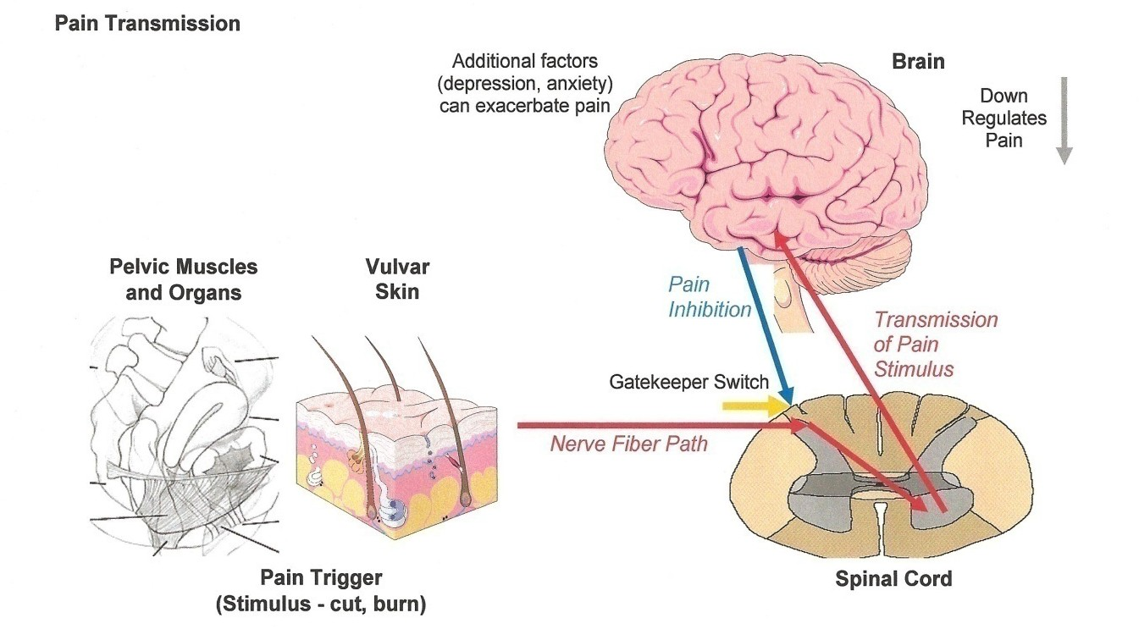
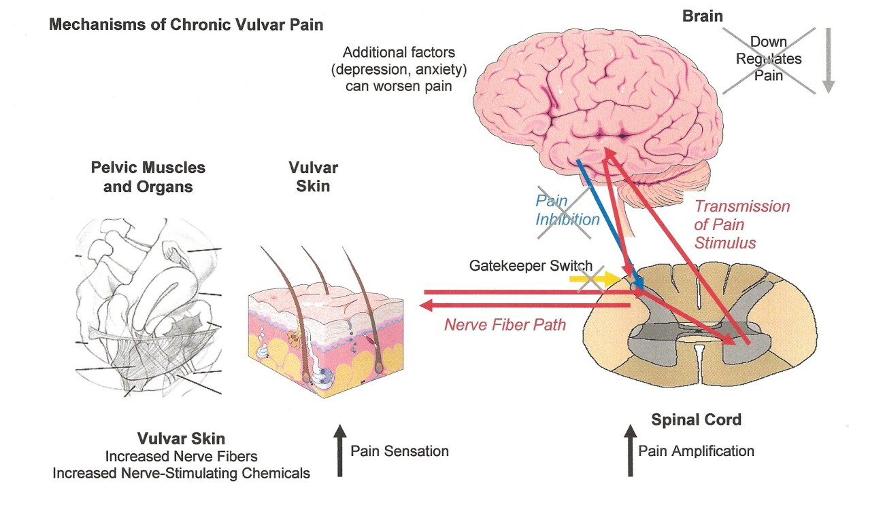
NORMAL PAIN TRANSMISSION VS. PROPOSED MECHANISMS OF ALTERED PAIN TRANSMISSION IN VULVODYNIA
Pathophysiology
Notes:
Our understanding of the pathophysiologic mechanisms of vulvodynia is in its infancy. This diagram compares the mechanisms of normal pain transmission to the proposed pathophysiologic transmission of pain in women with vulvodynia. It is likely that different mechanisms, influenced by several predisposing, triggering, and maintaining factors, as well as genetic and environmental factors, will be identified.

Slide 28
NEUROPROLIFERATION
One possible pathophysiologic mechanism of vestibulodynia is neuroproliferation (Bornstein 1997, Bornstein 2008).
Subepithelial and intraepithelial nerve fibers have been detected in patients with vestibulodynia.
Branching of the nerve fibers within the epithelium is rarely seen.
Pathophysiology
Notes:
One possible pathophysiologic mechanism of vestibulodynia is neuroproliferation. A special nerve fiber staining, PGP 9.5, was used to depict small nerve fibers in patients with vestibulodynia and women without vestibulodynia undergoing vestibular biopsy for other conditions. Subepithelial and intraepithelial nerve fibers were detected only in patients with vestibulodynia. The fibers penetrated the basal membrane and continued vertically for more than half the distance to the epithelial surface. Branching of the nerve fibers within the epithelium was rarely seen (Bornstein 1997, Bornstein 2008).

Slide 29
MAST CELLS
In vestibulodynia, there is frequently an increase in mast cell number and activity.
Mast cells show degranulation.
The discharged granules contain tryptase, histamine, serotonin, bradykinin, heparanase, nerve growth factor, etc.
Some of these enzymes may participate in the pathogenesis of vestibulodynia (Bornstein 2004).
Pathophysiology
Notes:
In vestibulodynia, there is frequently an increase in mast cell number and activity. In Bornstein et al, mast cells, stained by Giemsa, showed degranulation. The discharged granules contained tryptase, histamine, serotonin, bradykinin, heparanase, nerve growth factor, etc. Some of these enzymes may participate in the pathogenesis of vestibulodynia (Bornstein 2004).

Slide 30
Differential Diagnosis
Disorders known to cause vulvar pain (rule-out diagnoses)
vs.
Vulvodynia

Slide 31
POSSIBLE RISK FACTORS FOR VULVODYNIA
Postulated risk factors reported in the literature to date:
Vulvovaginal infection Oral contraceptive use Genetic variability
Dysmenorrhea, chronic pain in other areas of the body
Autoimmune disease, altered immuno- inflammatory response
Allergies, vulvar dermatologic disorders
Early age of first intercourse, pain with first intercourse, pain with/after sex
Early menarche Nulliparity
Childhood enuresis, nocturnal urination, Urinary burning, pain with wiping
Pain with bike riding
Difficulty or severe pain with first tampon use
Adverse life experiences
Differential Diagnosis
Notes:
Preliminary findings of research on factors associated with the risk of developing vulvodynia indicate that there may be multiple risk factors involved, but larger studies are needed to confirm these findings. Multiple studies suggest that vulvodynia patients experience more frequent vaginal infections; however, in most cases, prior vaginal infections were either self-reported or unconfirmed by the treating clinician. Research demonstrates that patients and clinicians are poor at accurately diagnosing vaginal infections (Ferris 1996, Ferris 2002, Ledger 2004, Schwiertz 2006). The only population-based case-control study to date that compared the frequency of self-reported urogenital infections before the onset of vulvar pain demonstrated that a history of genital warts (OR 3.4), trichomoniasis (OR 5.7), urinary tract infection (OR 2.0), or yeast infection (OR 2.1) was associated with increased risk of vulvodynia. The researchers also found that women with multiple infections prior to the onset of vulvar pain were at highest risk; a combination of urinary tract infection and sexually transmitted infections (STIs) was associated with a 10-fold higher risk (Nguyen 2009). Recent pathophysiologic studies have demonstrated a relationship between vulvodynia and Candida albicans (Babula 2004, Foster 2007, Ramirez De Knott 2005, Farmer 2011).
Research to date appears to implicate oral contraceptive (OC) use in the development and/or maintenance of vulvodynia in some subgroups. Some clinicians propose that the use of OCs, particularly at an early age, down-regulates estrogen receptors in the vulvovaginal tissue, causing the vestibular epithelium to become thin and fragile. In a study of women using Yasmin, Battaglia (2012) found decreased labial thickness, introital area, frequency of intercourse and orgasm during intercourse, as well as increased pain with intercourse and pulsatility index of the dorsal clitoral and posterior labial arteries. In another study, quantitative sensory testing of the vestibular mucosa in healthy women revealed significantly lower mechanical pain thresholds in the OC group, with the most sensitivity in the posterior vestibule. The investigators concluded that OCs may induce increased sensitivity in the vestibular mucosa in healthy women, possibly contributing to the development of vulvodynia (Bohm-Starke 2004). Heddini (2012) found that provoked vestibulodynia patients carrying a polymorphism in the guanosine triphosphate cyclohydrolase (GCH1) gene and using OCs had higher pain sensitivity compared to non-carriers. Several studies have demonstrated increased risk in this patient population (Sjoberg 1997, Greenstein 2007, Bazin 1994, Bouchard 2002), although a population-based study did not (Harlow 2008).
Other risk factors reported in the literature include a history of allergies (Harlow 2009); vulvar dermatoses (Coombs 2011); autoimmune disease (Driul 2011) and an altered immuno-inflammatory response (Breshears 2011); early age of menarche (Harlow 2001); dysmenorrhea (Granot 2004); difficulty or severe pain with first tampon use (Harlow 2003, Landry 2009, Legocki 2011); early age of first intercourse (Bazin 1994, Berglund 2002); pain with first intercourse (Legocki 2011); pain with/after sex (Reed 2012); nulliparity (Edgardh 2007); childhood nocturnal enuresis (Greenstein 2005); urinary burning (Reed 2012); nocturnal urination, pain with wiping, and bike riding (Legocki 2011); genetic variability (Babula 2008, Foster 2004, Gerber 2003, Jeremias 2000, Lev-Sagie 2009) and altered gene expression, particularly in genes implicated in osteoarthritis (Breshears 2011) and with an altered immuno-inflammatory response (Bornstein 2004, Bornstein 2008, Foster 1997, Foster 2007, Gerber 2002, Harlow 2009, Lev-Sagie 2009); and chronic pain in other areas of the body (Falik-Zaccai 2011, Arnold 2006, Heddini 2012). (See differential diagnosis references.)
Although one study supports some degree of association (Harlow 2005), several studies have refuted the notion that prior sexual and/or physical abuse is a risk factor for vulvodynia (Dalton 2002, Plante 2008, Edwards 1997, Reed 2000). Khandker (2011) is the only population-based epidemiological study to demonstrate antecedent depression and anxiety as risk factors for vulvodynia. Plante (2008) demonstrated that women with vulvodynia reported more adverse life experiences. See Bohm-Starke 2010 for additional information.

Slide 32
RULE-OUT DIAGNOSES
CHRONIC VULVAR PAIN
Visible and/or neurologic findings
No visible findings except possible erythema. Hyperalgesia (painful stimuli induce sensitivity). Allodynia (non-painful stimuli induces pain). Pain can be: primary or secondary; spontaneous or provoked; intermittent, persistent, constant, immediate, delayed
Infectious, inflammatory, neoplastic, neurologic, traumatic, iatrogenic, hormonal deficiencies (treat accordingly)
Pain is localized to one part of the vulva (vestibule, clitoris, labia, etc.)
Pain throughout the entire vulva though some parts may be more painful than others. Provocation typically exacerbates symptoms. Pain may be described as burning, stabbing, stinging, etc.
Generalized Vulvodynia
Clitorodynia - pain confined to the clitoris. Can be described as burning or stabbing pain or less commonly persistent arousal (AKA persistent genital arousal disorder - PGAD).
Vestibulodynia (AKA vulvar vestibulitis (VVS) or provoked vestibulodynia (PVD). Primary if pain began at first vaginal penetration attempt. Secondary if pain began after a period of pain-free vaginal penetration.
Haefner 2007, Bornstein 2016
Differential Diagnosis
Notes:
According to the International Society for the Study of Vulvovaginal Disease (ISSVD) (Bornstein 2016), known causes of chronic vulvar pain are: (1) infectious, (2) inflammatory, (3) neoplastic, (4) traumatic, (5) iatrogenic, (6) hormonal deficiencies, or (7) neurologic. If the cause is unknown, it is classified as vulvodynia. Conditions falling into the first 7 categories must be ruled out prior to making a diagnosis of vulvodynia. Examples of some of these prevalent conditions follow, with references to journal articles that provide information on diagnosis and treatment since this is beyond the scope of the current program.

Slide 33
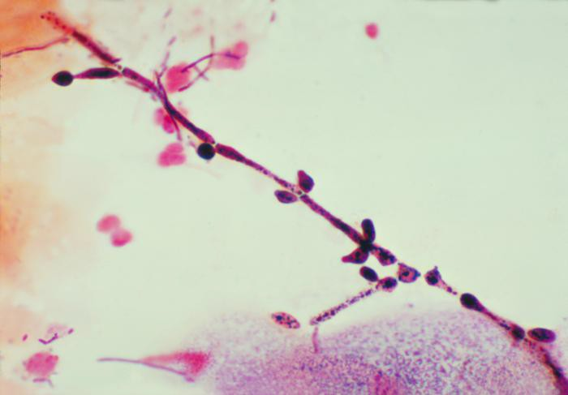
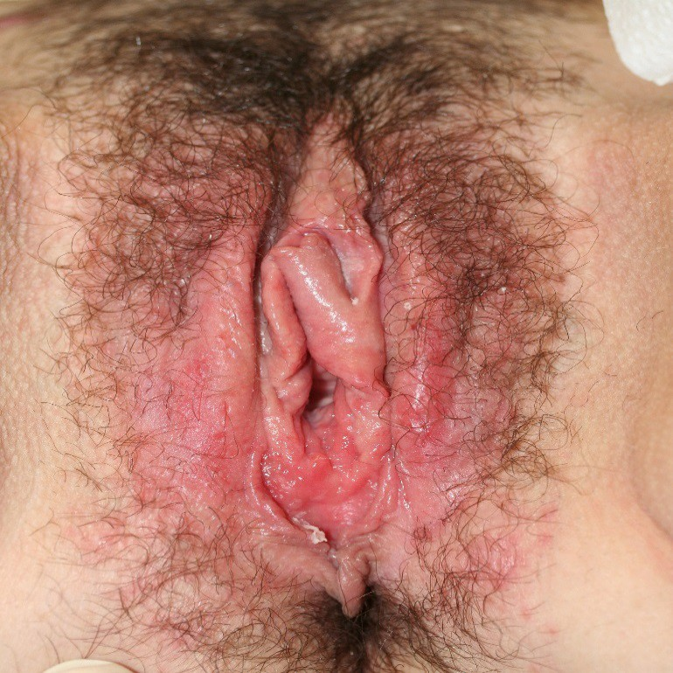
RULE-OUT DIAGNOSES
INFECTIOUS DISORDERS
Vulvovaginal Candidiasis
Courtesy of CDC Public Health Image Library
Courtesy of Dr. Andrew Goldstein
For information on diagnosis and treatment, see Ledger 2007 and Nyirjesy 2008.
Differential Diagnosis
Notes:
The image on the left is a vaginal smear identifying Candida albicans, using a gram stain technique. In-office diagnosis can be made with microscopy using a potassium hydroxide prep, and vaginal culture can be used for speciation and sensitivity. C. albicans is a component of the normal flora in many women. Under certain conditions, such as a hormone imbalance, antibiotic treatment, or transient localized immune suppression, C. albicans can multiply, resulting in a symptomatic condition known as vulvovaginal candidiasis. Recent studies have implicated recurrent or chronic vulvovaginal candidiasis as a causative factor in vulvodynia.
It should be noted that the microbiome of the vagina is very complex and many species of bacteria, which may be considered pathogens in other parts of the body, are not pathogens in the vagina. Bacterial species such as Group b strep, Klebsiella, and Escherichia coli are common in the vagina and should not be treated.

Slide 34
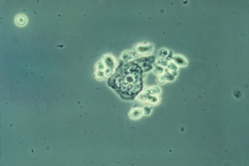
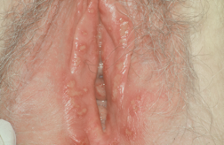
RULE-OUT DIAGNOSES
INFECTIOUS DISORDERS
Trichomoniasis
Genital Herpes
Courtesy of CDC Public Health Image Library
Courtesy of Dr. Libby Edwards
For information on diagnosis and treatment, see Ledger 2007, Soper
2004 & Schwebke 2004.
For information on diagnosis and treatment, see Ledger 2007 &
Kimberlin 2004.
Differential Diagnosis
Notes:
The image on the left is a phase contrast wet mount micrograph of a vaginal discharge revealing the presence of Trichomonas vaginalis protozoa. Trichomoniasis is an STI that causes itching, irritation and abnormal discharge.
As seen on the right, genital herpes simplex (virus 1 or 2) infection typically presents as one or more blisters on or around the genitals or rectum. The blisters break, leaving tender ulcers that may take 2 to 4 weeks to heal the first time they occur. Frequently, genital herpes presents with more subtle signs, such as a small fissure or break in the skin. Viral shedding can also occur in the absence of visible manifestation.

Slide 35
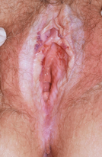
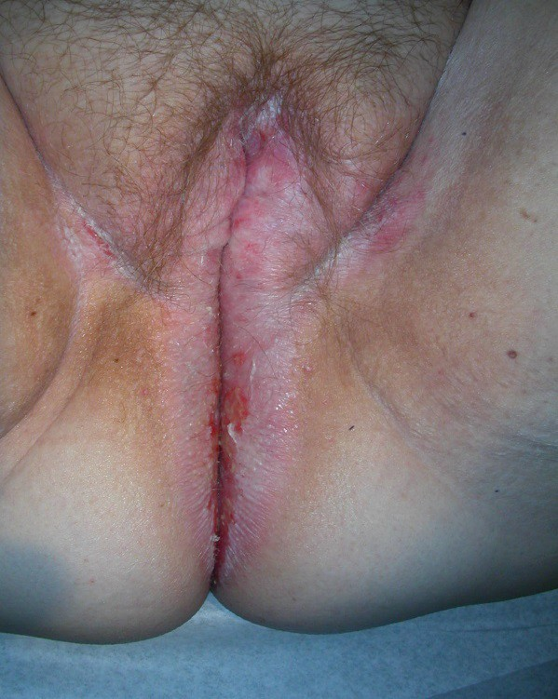
RULE-OUT DIAGNOSES
INFLAMMATORY DISORDERS
Lichen Sclerosus
Image courtesy of Dr. Libby Edwards
Image courtesy of Dr. Andrew Goldstein
For information on diagnosis and treatment, see Chi 2012, Moyal-Barracco 2014.
Differential Diagnosis
Notes:
Lichen sclerosus (LS) is a chronic inflammatory condition of the vulva, most likely of autoimmune etiology. Both photos show cases of LS, but the photo on the left shows a severe case with a whitish color, itching, and fragile skin that may bruise or tear with contact or sexual intercourse. Diagnosis should be confirmed with vulvar skin biopsy evaluated by a dermatopathologist prior to initiating treatment with ultra-potent topical corticosteroids.

Slide 36
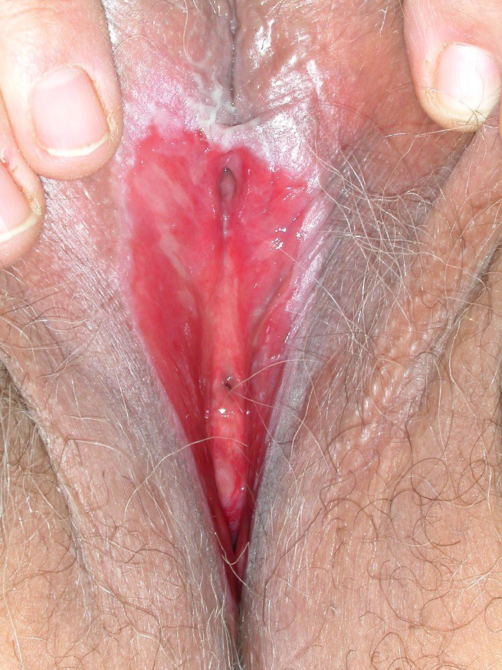
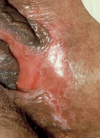
RULE-OUT DIAGNOSES
INFLAMMATORY DISORDERS
Lichen Planus
Image courtesy of Dr. Andrew Goldstein
Image courtesy of Dr. Libby Edwards
For information on diagnosis and treatment, see Lewis 2013, Moyal-Barracco 2014, Burrows 2008.
Differential Diagnosis
Notes:
Erosive lichen planus is another autoimmune skin disorder that can affect the vulva. As seen in these photos, lichen planus typically presents with white irregular lines and deep red areas of painful erosions.

Slide 37
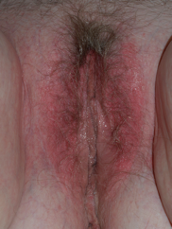
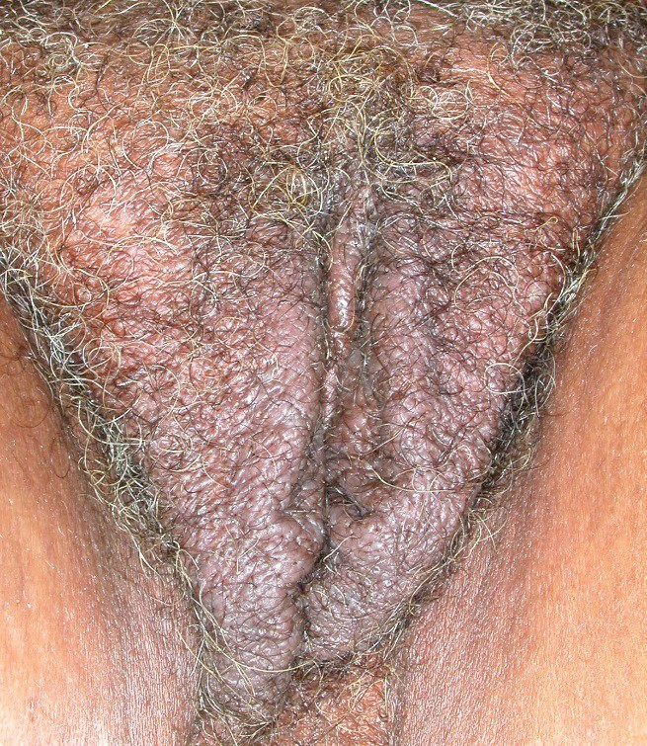
RULE-OUT DIAGNOSES
INFLAMMATORY DISORDERS
Contact Dermatitis
Lichen Simplex Chronicus
Courtesy of Dr. Libby Edwards
For information on diagnosis and treatment, see Burrows 2008 & Margesson 2004.
Courtesy of Dr. Andrew Goldstein
For information on diagnosis and treatment, see Moyal-Barracco 2014.
Differential Diagnosis
Notes:
The photo on the left shows nondescript redness in a woman who has an irritant contact dermatitis from using a harsh soap. Contact dermatitis is a rash resulting from the skin’s reaction to an external substance (eg, ointments, soaps, detergents, dyes or sanitary pads). The rash may occur suddenly with blisters, itching, and weeping or it may be of slower onset with redness, burning, and some swelling. There are 2 types of contact dermatitis: irritant and allergic. Irritant dermatitis is the most common type causing burning, rawness, and/or irritation. Allergic dermatitis may be mild, with simply minor redness, swelling, and itching or severe, with blistering, bright red swelling, and severe discomfort.
The primary symptom of lichen simplex chronicus (also known as eczema, atopic dermatitis, neurodermatitis) is itching. Pain and skin abnormalities result from rubbing or scratching, as can be seen from the rubbed and thickened skin in this photo. Lichen simplex chronicus frequently starts because of chronic inflammation from chronic/recurrent candidiasis, recurrent exposure to an irritant and/or allergen, or, less commonly, vulvar intraepithelial neoplasia (VIN). This chronic inflammation causes an itch-scratch cycle that leads to lichen simplex chronicus. Treatment consists of treating the infectious organism or removal of the allergen or irritant exposure. Application of ice and an antihistamine or tricyclic antidepressant are then used to stop the pruritus to break the itch-scratch cycle. Lastly, a potent topical corticosteroid is used to reduce the inflammation.

Slide 38
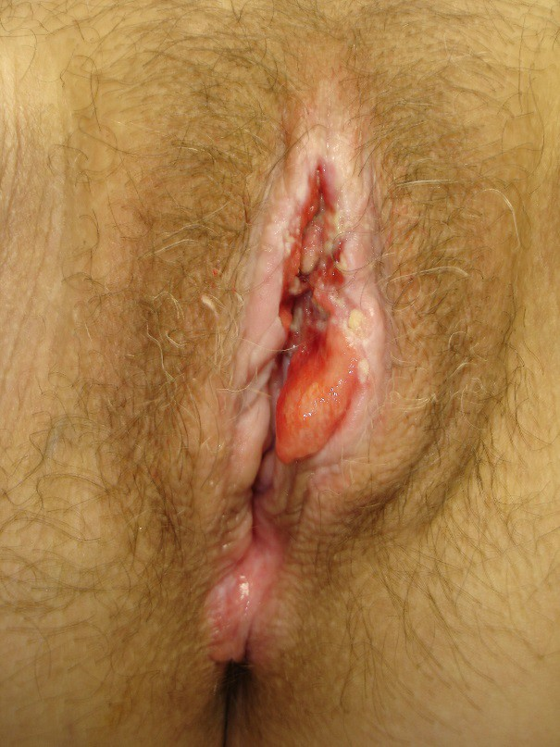
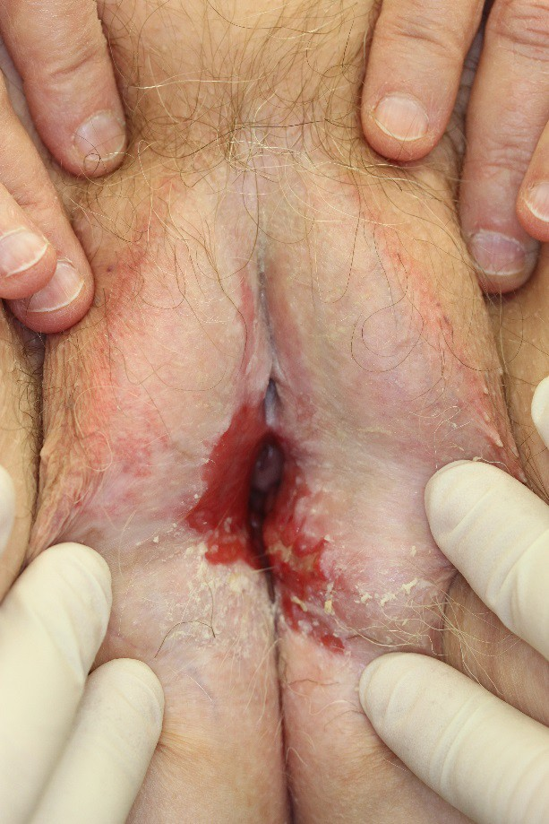
RULE-OUT DIAGNOSES NEOPLASTIC DISORDERS
Squamous Cell Carcinoma
Images courtesy of Dr. Andrew Goldstein
For information on diagnosis and treatment, see Alkatout 2015.
Differential Diagnosis
Notes:
These photos show vulvas with squamous cell carcinoma (SCC) on a background of LS. SCC can develop in 3% to 5% of women with LS. An additional cause of vulvar SCC is human papillomavirus (HPV) infection, which can cause vulvar intraepithelial neoplasia and then progress to SCC. Additionally, melanoma and Paget disease can occur on the vulva. Therefore, in any patient with persistent ulceration, a mass, or irregular pigmented lesion, the clinician should perform a vulvar biopsy to rule out malignancy.

Slide 39
RULE-OUT DIAGNOSES
NEUROLOGIC DISORDERS
Pudendal, Genitofemoral and/or Ilioinguinal Nerve Injury
Can be caused by several different insults including: childbirth, sports injuries, trauma and surgery (for incontinence or for vaginal vault prolapse) (see Paulson 2011, Masata 2012, Parnell 2012, Bekker 2012)
Differential Diagnosis

Slide 40
RULE-OUT DIAGNOSES
NEUROLOGIC DISORDERS
Pudendal Neuralgia due to Nerve Entrapment* (see Peng 2009, Insola 2010)
Diagnosed by presence of all five Nantes Criteria: 1) pain in the anatomical territory of the pudendal nerve, 2) worse on sitting, 3) not usually waking the patient at night, 4) not accompanied by any objective perineal sensory loss, with 5) a positive anesthetic block of
the pudendal nerve at the ischial spine (Labat 2010)
Patients often present with associated urinary, anorectal, sexual, neuromuscular, and hypersensitization signs, which can complicate the diagnostic approach and therapeutic management (Labat 2010).
*These disorders are many times also diagnoses of exclusion, and can, therefore, be difficult to definitively differentiate from vulvodynia.
Differential Diagnosis

Slide 41
RULE-OUT DIAGNOSES
NEUROLOGIC DISORDERS
Peripheral Neuropathy/Neuralgia*
Neuropathy induced by diabetes, chemotherapy, multiple sclerosis (see Stavraka 2012, Loprinzi 2008)
Herpes zoster virus can lead to post-herpetic neuralgia masking as vulvodynia (see Oaklander 2002).
Pharmacologic toxicity, eg, nitrofurantoin (see Tan 2012)
*These disorders are many times also diagnoses of exclusion, and can, therefore, be difficult to definitively differentiate from vulvodynia.
Differential Diagnosis

Slide 42
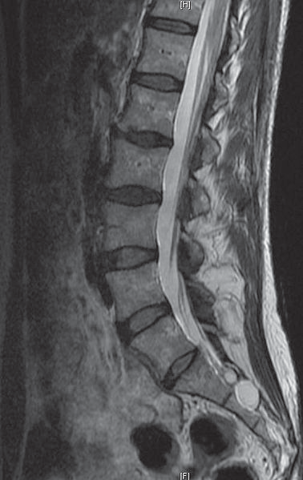
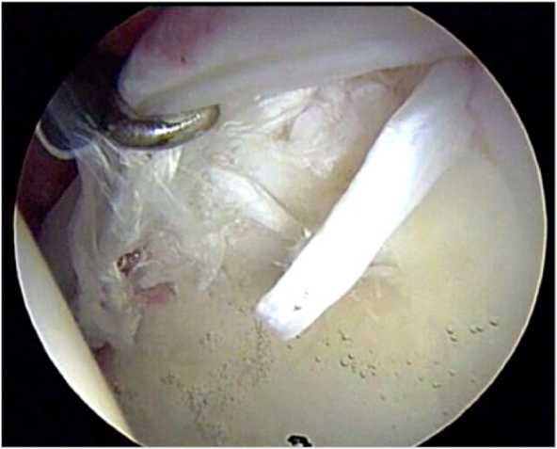
RULE-OUT DIAGNOSES
NEUROLOGIC (AND OTHER) DISORDERS
Sacral Meningeal (Tarlov) Cysts (see Hiers 2010, Van de Kleft 1991)
Referred pain from ruptured disc or scarring around sacral nerve roots after disc surgery, pelvic floor muscle dysfunction and/or orthopedic condition, e.g., labral hip tear (image below)
Image courtesy of Wikimedia Commons
Image courtesy of Deborah Coady
Differential Diagnosis
Notes:
The MRI on the left shows a Tarlov cyst, a cerebrospinal fluid (CSF)-filled sac located in the spinal canal at the S1-S4 region of the spinal cord. Patients with Tarlov cysts are usually asymptomatic, but some do experience radiating pelvic and urogenital pain, persistent genital arousal disorder (PGAD), sexual dysfunction, and bladder dysfunction, among other symptoms.
The image on the right shows a labral hip tear, which can refer pain to the urogenital region.

Slide 43
RULE-OUT DIAGNOSES TRAUMA
Trauma to the vulva may lead to chronic vulvar pain.
Female genital cutting
Perineal trauma
Straddle injuries
  Bicycles
  Falls from climbing
Injuries to pelvis
  Motor vehicle accidents
Differential Diagnosis
Notes:
More than 130 million women across the world have undergone female genital cutting (FGC) and in some countries prevalence of FGC is greater than 85% (UNICEF 2014).
Perineal trauma from a poorly healed or poorly repaired laceration or episiotomy may cause chronic vulvar pain or recurrent tearing (and pain) during intercourse. A recent review showed that 12.8% of women experience chronic vulvar pain at least 5 months after episiotomy (Turmo 2015).
Lastly, straddle injuries (most commonly from bicycles or falls from climbing) or injuries to the pelvis from motor vehicle accidents are uncommonly the cause of persistent vulvar pain.

Slide 44
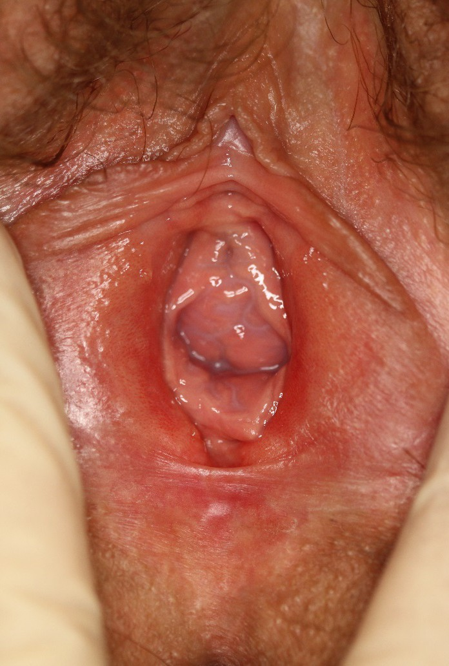
RULE-OUT DIAGNOSES
HORMONAL DEFICIENCIES
Courtesy of Dr. Andrew Goldstein
Differential Diagnosis
Notes:
It has been recognized for decades that the tissues of the vulva and vagina are both responsive and dependent on sex steroids (hormones) for proper health and function. These sex steroids exert their effects through the nuclear receptors of estrogen, progesterone, androgen and glucocorticoid. The hormone receptors are abundant in the epithelium of the outer vulva, endothelium of the vestibule, and mesothelium of the vagina. In addition, these hormone receptors are also found in high concentration in the deeper tissues of the vulva and vagina, including the glands and connective tissue, and adjacent to blood vessels and nerves. The hormones bind to the hormone receptors, which then leads to transcription and production of proteins that are essential for genital health and normal sexual function. Conversely, a deficiency in the sex steroids leads to dysfunction and, frequently, dyspareunia. It has been very well documented that a deficiency in circulating estrogen leads to anatomic and physiologic changes in the vagina. Anatomic changes include reduced collagen density and hyalinization, decreased elastin, thinning of the epithelium, altered appearance and function of smooth muscle cells, increased density of connective tissue, and fewer blood vessels. The labia minora thin and regress, the vestibule retracts, and the hymenal carunculae involute and lose elasticity. The urethral meatus appears prominent relative to the vestibule and becomes vulnerable to physical irritation and trauma. Physiologic changes result in reduced vaginal blood flow, diminished lubrication, decreased flexibility and elasticity of the vaginal vault, and increased vaginal pH. Furthermore, decreases in vaginal tissue strength and increased friability may predispose to epithelial damage with penetrative sexual activity, leading to pain, burning, tearing, irritation, and post-coital bleeding. Epithelial thinning with decreased glycogenated superficial cells leads to changes in vaginal flora and loss of lactobacilli, increased pH, and a change in the microbiome. More recently, it has become apparent that deficiency in circulating free testosterone also adversely affects the tissues of the vulva and vagina. Decreased levels of androgens are associated with decreased mucinification, decreased nerve fiber density, and decreased vasodilation.

Slide 45
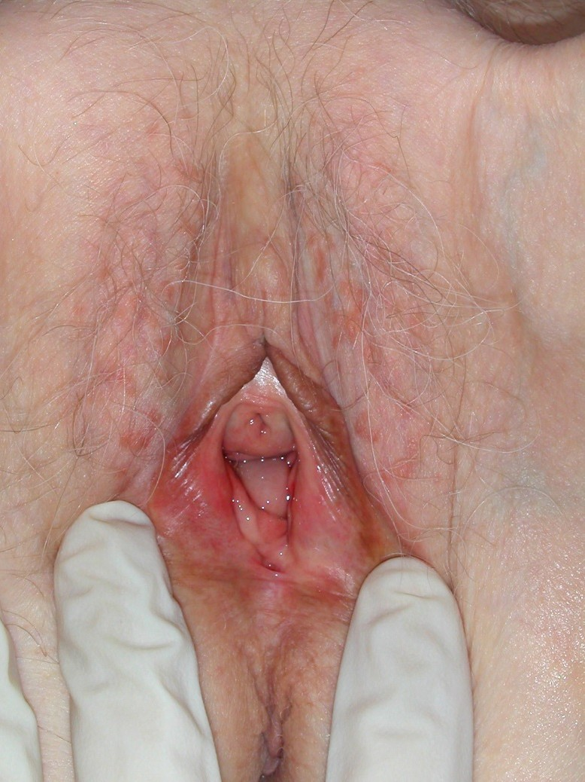
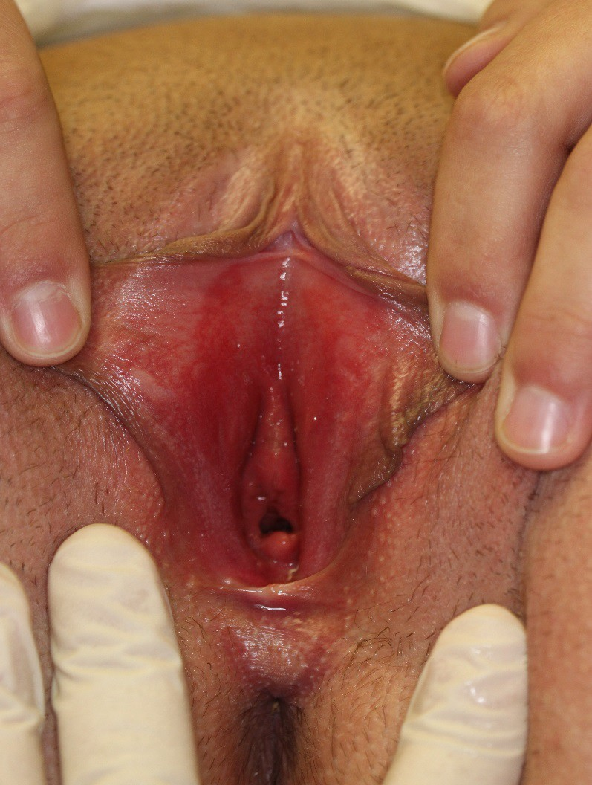
RULE-OUT DIAGNOSES IATROGENIC
Images Courtesy of Dr. Andrew Goldstein
Differential Diagnosis
Notes:
As seen in these photographs, women who receive adjuvant endocrine therapy after the diagnosis of breast cancer (with an aromatase inhibitor or Tamoxifen), have a significant increase in dyspareunia (Baumgart 2013).
Prophylactic oophorectomy in women with BRCA mutations also increases the rate of dyspareunia (Finch 2011).
Sixty-seven percent of women who receive pelvic radiation therapy for anogenital malignancies develop dyspareunia (Stinesen 2015).
Repair of pelvic organ prolapse with synthetic vaginal mesh may have significant complications, including mesh contraction; mesh erosion into the vagina, bladder, and bowel; and dyspareunia. A meta-analysis of 71 papers showed that the overall rate of chronic dyspareunia after mesh placement is 9.1% (Abed 2011).

Slide 46
VULVODYNIA ASSESSMENT
CHRONIC VULVAR PAIN
Visible and/or neurologic findings
No visible findings except possible erythema. Hyperalgesia. Allodynia. Pain can be: primary or secondary; spontaneous or provoked; intermittent, persistent, constant, immediate, delayed
Infectious, inflammatory, neoplastic, neurologic, trauma,iatrogenic, hormonal deficiencies (treat accordingly)
Pain is localized to one part of the vulva (vestibule, clitoris, labia, etc.)
Pain throughout the entire vulva though some parts may be more painful than others. Provocation typically exacerbates symptoms. Pain may be described as burning, stabbing, stinging, etc.
Generalized vulvodynia
Clitorodynia - pain confined to the clitoris. Can be described as burning or stabbing pain or less commonly persistent arousal (also know as persistent genital arousal disorder - PGAD).
Vestibulodynia (aka vulvar vestibulitis or provoked vestibulodynia (PVD)). Primary if pain began at first vaginal penetration attempt. Secondary if pain began after a period of pain-free vaginal penetration.
Haefner 2007, Bornstein 2016
Differential Diagnosis
Notes:
After visible and/or neurologic causes of vulvar pain are identified and treated, one moves on to evaluate the patient for vulvodynia. Hyperalgesia and allodynia are present, with or without the presence of erythema. Although women with vulvodynia describe their pain in a variety of ways (eg, stabbing, aching, raw, searing, sharp, throbbing, knife-like, etc), burning is most commonly reported. If the pain is localized to the vulvar vestibule and provoked, the diagnosis is likely to be provoked vestibulodynia (PVD). PVD is further categorized as primary or secondary. PVD is the most common subtype affecting 80% of women with chronic vulvar pain symptoms (Harlow 2003). If the pain is generalized to multiple areas of the vulva and spontaneous, but exacerbated by touch/pressure, the diagnosis is likely generalized vulvodynia. Twenty percent of women suffer from this subtype or a mixture of both (Reed 2003, Edwards 2004).

Slide 47
VULVODYNIA ASSESSMENT SCREENING QUESTIONS
Four Questions Highly Predictive of a Clinical Diagnosis
Experience genital “pain”?
Experience genital burning > 3 months?
10 or more episodes of pain on contact with tampon insertion, sexual intercourse or gynecological exam?
Does pain on contact limit/prevent intercourse?
Harlow 2009
Differential Diagnosis
Notes:
Based on data from a National Institutes of Health (NIH)-funded population-based study, these 4 questions have been found to be highly predictive of an office-based diagnosis of vulvodynia (Harlow 2009). These questions were validated against clinical examination with 80% specificity and 95% sensitivity. They should be included on screening forms to help healthcare practitioners identify women and adolescents who may be suffering from the condition.

Slide 48
2015 ISSVD, ISSWSH, IPPS CONSENSUS TERMINOLOGY AND CLASSIFICATION OF VULVODYNIA
Vulvodynia is vulvar pain of at least 3 months duration, without a clear identifiable cause, which may have potential associated factors.
Descriptors:
Localized (e.g., vestibulodynia, clitorodynia), generalized or mixed (localized and generalized)
Provoked (eg, insertional, contact), spontaneous or mixed (provoked and spontaneous)
Onset (primary or secondary)
Temporal pattern (intermittent, persistent, constant, immediate, delayed)
Bornstein 2016
Differential Diagnosis
Notes:
For more than a decade, gynecologists, dermatologists, vulvar pain specialists, and researchers have used the 2003 ISSVD terminology as a guide to diagnosing vulvar pain. This terminology evolved over years of discussion on the nature of idiopathic vulvar pain, especially that occurring during sexual activity and vaginal penetration. The 2003 terminology divided vulvar pain into 2 overarching categories: vulvar pain related to a specific disorder and vulvodynia, defined specifically as “vulvar discomfort, most often described as burning pain, occurring in the absence of relevant visible findings or a specific, clinically identifiable, neurologic disorder.” Therefore, the term vulvodynia was reserved for those cases in which the pain could not be attributed to an identifiable “visible” cause.
Since 2003, the category of identifiable causes of vulvar pain has evolved substantially, as have the potential factors associated with vulvodynia. These developments are based on the results of numerous studies examining a wide range of possible etiologic factors (eg, inflammatory, genetic, musculoskeletal, neurosensory, neuropathic) and treatment avenues (eg, oral medication, pelvic floor physical therapy, surgical intervention, psychologic intervention). These studies have also led to the conclusion that vulvodynia is likely not one disease but a constellation of symptoms of several (sometimes overlapping) disease processes that benefits most from a range of treatments based on individual presentation. These studies have widened the scope of etiologic considerations and have resulted in the need to update the description and nomenclature of persistent vulvar pain. In addition, several important pain characteristics of vulvodynia have been introduced (eg, primary and secondary status; intermittent and constant pain pattern).

Slide 49
VULVODYNIA ASSESSMENT
COMPONENTS OF THE EXAMINATION
After all infectious, inflammatory, neoplastic, neurologic, and other disorders are identified and treated, women are assessed for vulvodynia through a five-step examination, as described in the following slides.
Step 1: Visual Examination
Step 2: Cotton-Swab Examination of the Vulva and Vulvar Vestibule
Step 3: Neurosensory Examination
Step 4: Pelvic Floor Muscle Examination
Step 5: Evaluation of Pain Comorbidity & Contributing Factors
Differential Diagnosis

Slide 50
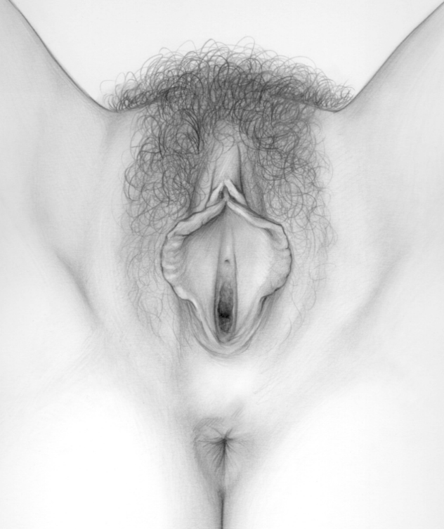

VULVODYNIA ASSESSMENT
SUBJECTIVE FINDINGS: “WHERE DOES IT HURT?”
Generalized Vulvodynia
“It hurts all over, all of the time.”
Provoked Vestibulodynia
“It hurts at the opening only with touch or pressure.”
Less prevalent (20%) subtype
More prevalent (80%) subtype
Differential Diagnosis
50
Notes:
As shown on the left, most women with generalized vulvodynia report spontaneous pain in multiple areas of the vulva. Pain tends to be constant, but may be intermittent in some women. Although symptoms are spontaneous, they tend to worsen with provocation. Periods of unexplained pain relief and/or flares can occur. Erythema may or may not be present. This subtype affects 20% of those reporting chronic vulvar pain symptoms (Harlow 2003).
As shown on the right, women with PVD report provoked pain only within the vulvar vestibule. Erythema may co-occur. This subtype affects 80% of those with vulvar pain (Harlow 2003).
A subset of women report spontaneous widespread vulvar pain, as well as provoked pain localized to the vestibule. The above subtypes may coexist in some women (Reed 2003, Edwards 2004).

Slide 51
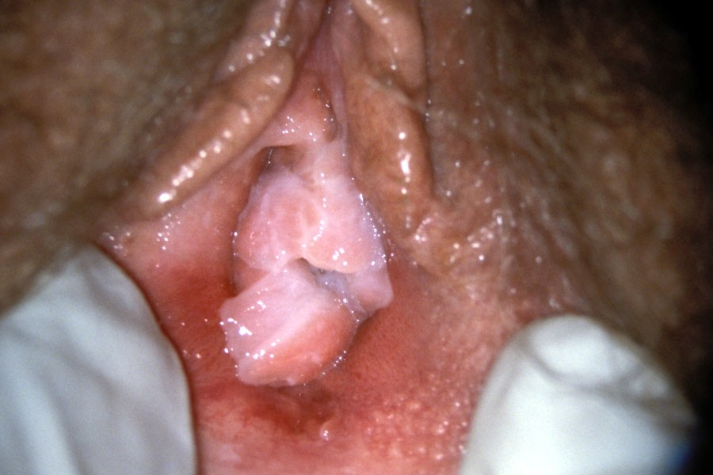
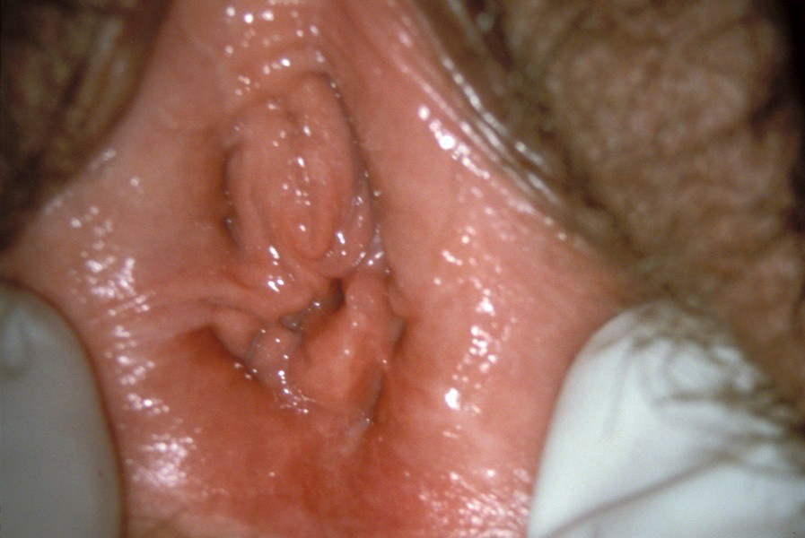
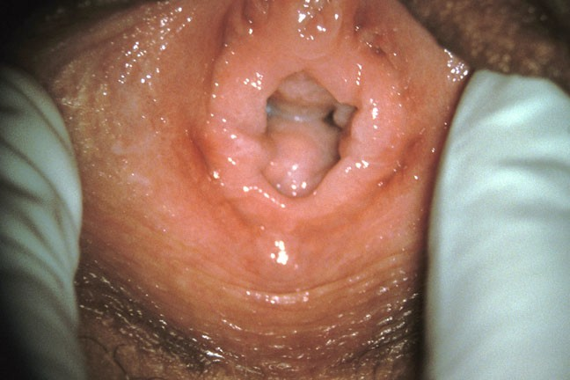
VULVODYNIA ASSESSMENT
STEP 1: VISUAL EXAMINATION
Patient #1
Severe Erythema
Patient #2
Moderate Erythema
Patient #3
Minimal Erythema Severe Pain
Pain severity and subsurface inflammation do not consistently correlate with the amount of erythema observed (Bergeron 2001, Farage 2009).
Reprinted with permission from Ledger, W.J. and Witkin, S.S., Vulvovaginal Infections, Manson Publishing, London, 2007, page 103.
Differential Diagnosis
Notes:
Women may present with marked introital erythema, as seen in patient #1, or the tissue may appear relatively normal, as seen in patient #3. Although patient #3 presented with minimal erythema, she had severe pain that prevented her from engaging in sexual intercourse or inserting a tampon. Recent studies have also shown that pain severity and subsurface inflammation do not consistently correlate with the severity of erythema observed. The relevance of this criterion is disputed.

Slide 52
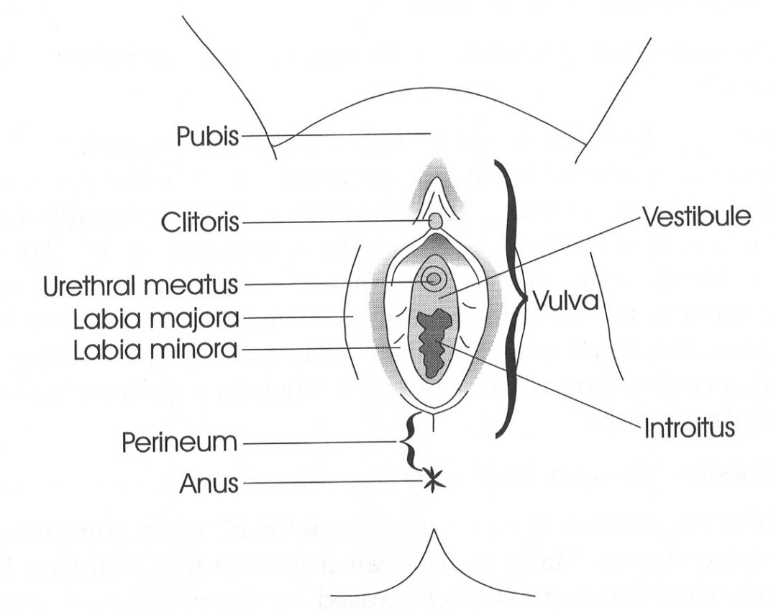
VULVODYNIA ASSESSMENT
STEP 2: COTTON SWAB EXAMINATION OF THE VULVA
Using a cotton swab, test for allodynia, hypo- and hyperalgesia by applying
gentle pressure to the following areas:
1-2 inner thigh
3-5 labia majora
6-8 interlabial sulcus
9 clitoris, clitoral hood
10 perineum
11 sites within vestibule (next slide)
1
9
3 6
4 7
5
11
8
For each site, the patient:
Rates the pain severity (VAS score)
Describes the pain character (burning, raw, etc.)
10
2
Differential Diagnosis
Notes:
Current guidelines recommend that a cotton swab test be performed (Haefner 2005). The 11 sites shown on this diagram should be tested for allodynia and hypo- or hyperalgesia by applying gentle pressure with a dry cotton swab (just enough to slightly indent the skin). If symptoms are provoked and localized to the vestibule, a more thorough evaluation of the vestibule is warranted and is described in the next slide.

Slide 53
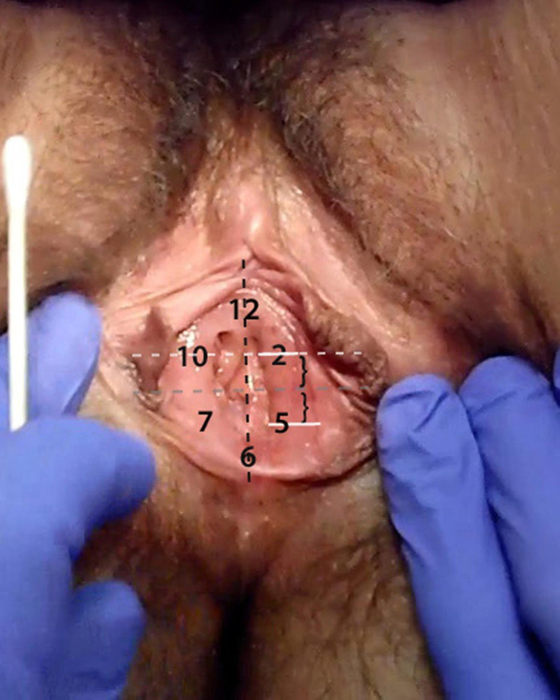
VULVODYNIA ASSESSMENT
STEP 2: COTTON SWAB EXAMINATION OF VULVAR VESTIBULE
Image courtesy of Dr. Denniz Zolnoun
Differential Diagnosis
Notes:
Sites to be tested within the vulvar vestibule can be visualized using a clock face (1 to 12 o’clock) with one vertical and one perpendicular (black) line through the center of the vaginal opening. The 2 and 5 o’clock positions are equidistant to both lines, as are the 7 and 10 o’clock positions. The anterior vestibular sites (2, 10 and 12) are typically assessed first, followed by the posterior sites (5, 6 and 7). Again, gentle pressure is applied to each of these sites and women are asked to rate the pain severity and describe the character of the pain they experience (Zolnoun 2012).

Slide 54
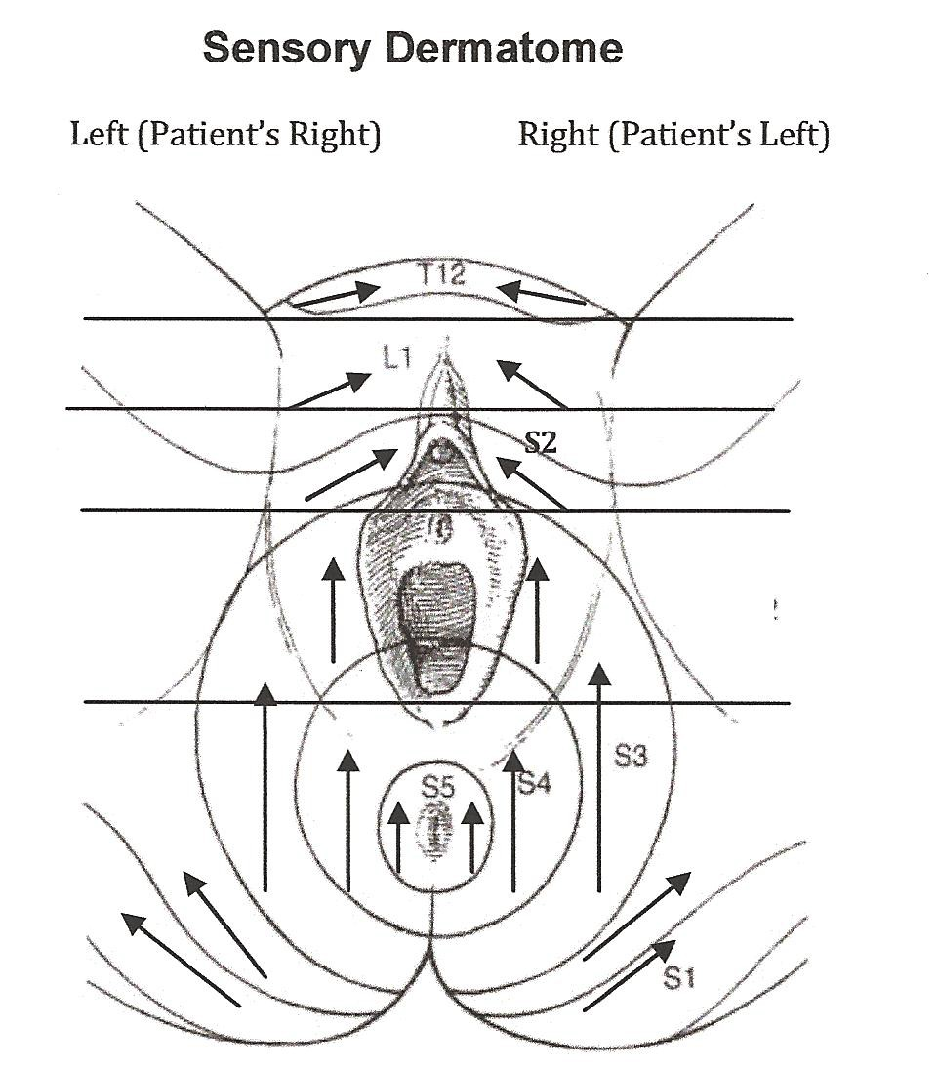
VULVODYNIA ASSESSMENT
STEP 3: NEUROSENSORY EXAMINATION
Instruct the patient on ‘cotton’ vs. ‘pin- prick’ sensation by touching her outer
thigh (just above the knee) with the cotton portion, followed by the wooden portion, of the cotton swab
Using the cotton swab, gently stroke (upwards) each of the sensory dermatomes
Note sensation (normal, allodynia, hypo-
sensitive), pain score, pain character (eg,
sharp, burning, shooting), and right- to left- side differences
Break the cotton swab in half and repeat exam with the sharp wooden portion of the swab using punctate pressure (apply light
pressure for 1 sec) in each dermatome
• Note sensation (normal, allodynia, hypo-
sensitive), pain score, pain character (eg,
sharp, burning, shooting), and right- to
left-side differences
From ongoing NIH Grant 5K23HD053631
Differential Diagnosis
Notes:
NIH-funded foundational work at the University of North Carolina at Chapel Hill is currently ongoing to refine a vulvovaginal neurosensory examination (described in this slide). Current prospective patient-reported outcomes studies are underway to delineate the exam components that are clinically relevant and predictive of treatment response (PI Zolnoun, NIH Grant 5K23HD053631, description available at: https://projectreporter.nih.gov/project_info_results.cfm?aid=7927135&icde=0).

Slide 55
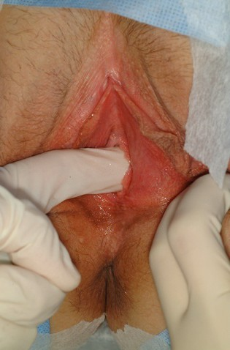
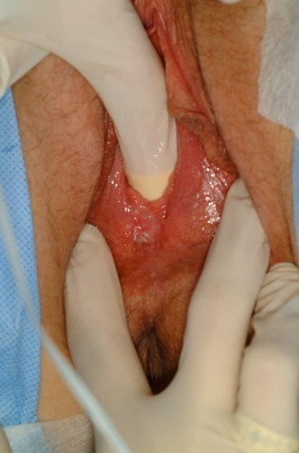
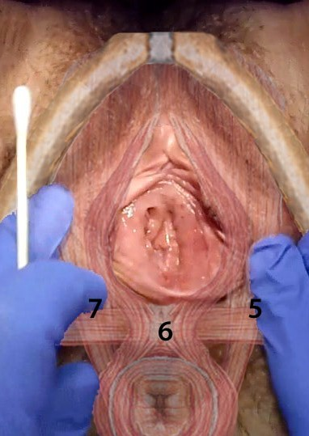
VULVODYNIA ASSESSMENT
STEP 4: PELVIC FLOOR MUSCLE EXAMINATION
Images courtesy of Dr. Denniz Zolnoun
Differential Diagnosis
Notes:
The muscle assessment begins with the examiner’s right index finger (bent approximately 30 to 60 degrees) palpating the patient’s right mid-pubic rami, which is the bony landmark for identifying the mid-segment (belly) of puborectalis muscle. After confirming the mid-position placement of the index finger, the examiner palpates the puborectalis muscle, which is immediately adjacent/behind the pubic rami. Then, the examiner rotates the index finger downwards (approximate length of 1 to 1.5 cm) parallel to the length of puborectalis, until the transition point/insertion to the superficial muscles (perineal muscle complex) is palpated. Using the left index finger, the examiner assesses the left puborectalis as described above and seen in this slide. The perineal muscle complex, which is immediately beneath the 6 o’clock mucosal position, is palpated last. These muscle sites are adjacent to the respective lower vestibular mucosal sites (5, 6, and 7). Women are asked to describe the pain character and rate the pain severity they experience (Zolnoun 2012).

Slide 56
VULVODYNIA ASSESSMENT
STEP 5: EVALUATION OF PAIN COMORBIDITY & CONTRIBUTING FACTORS
As a consequence of living with a poorly understood, under-recognized genital pain disorder, women commonly report emotional distress and sexual impairment.
Comorbid pain syndromes are also common, including:
Interstitial Cystitis | Irritable Bowel Syndrome | Endometriosis
Orofacial Pain (TMJ) | Chronic Headache (Migraine, Tension Type)
Fibromyalgia | Chronic Fatigue Syndrome
Assessment of comorbid disorders is important in selecting therapies that target all factors contributing to a woman’s current pain state, including:
Pain (location(s), intensity & interference)
Emotional Functioning
Sleep Interference (both falling asleep & staying asleep)
Physical Functioning
Sexual Functioning
See Comorbidity References.
Differential Diagnosis
Notes:
Women with vulvodynia commonly report suffering from comorbid pain disorders, mood/sleep alteration, and sexual impairment. It is vital to assess all of the factors that are contributing to a woman’s current pain state to delineate the most appropriate components of an individualized, multidisciplinary treatment regimen.
In a 2008 literature review, Desrochers critically examined studies on the psychosexual aspects of vulvodynia and concluded that, despite the presence of methodologic limitations, some findings were consistently replicated. Overall, women with vulvodynia demonstrated impaired sexual functioning, including lower levels of sexual desire, arousal, and frequency of intercourse. Additionally, questionnaires revealed that anxiety, fear of pain, hypervigilance and depression were more prevalent among these women. Desrochers concluded that more rigorous studies are needed to establish whether psychosexual variables exacerbate and/or maintain vulvodynia.
A growing body of literature documents the association between vulvodynia and other chronic pain conditions. Warren (2008) proposed that vulvodynia may be a referred pain of interstitial cystitis (IC) in many cases. Several authors have proposed that both IC and vulvodynia are syndromes of the urogenital sinus-derived epithelium (McCormack 1990, Burrows 2008). Peters (2008) speculated that the conditions may be linked by common pelvic floor muscle dysfunction. Others have proposed that a common pathway may stimulate a single disease process (Kennedy 2007), or that in some women, IC and vulvodynia may be the same disease (Peters 2008).
Recently, researchers have explored the relationship between vulvodynia and orofacial pain, specifically temporomandibular disorders. Zolnoun (2008) speculated that a subset of vulvodynia patients may suffer from a widespread musculoskeletal pain disorder influenced more by genetic makeup and central nervous system dysfunction than by an inflammatory process in the vulva.
Kennedy (2007) proposed that: irritable bowel syndrome (IBS) may predispose women to certain vulvar conditions (perhaps by the irritant nature of diarrhea, for example), treatment for vulvar conditions may lead to bowel symptoms, or both conditions may represent a “pelvic floor pain disorder.”
When studying the relationship between fibromyalgia and vulvodynia, Pukall (2005, 2006) proposed that the mechanisms involved in vulvodynia may be genital-specific in some women and possibly centrally mediated in others. Whether the generalized sensitivity or vulvar pain occurs first is unknown. For example, an untreated vulvar irritation could lead to central changes in sensory processing in genetically predisposed women, resulting in altered central pain processing and a widespread increase in sensitivity. On the other hand, women with vulvodynia may be more sensitive to pain in general and develop vulvar pain through a locally occurring event, such as a vulvar injury.

Slide 57
VESTIBULODYNIA: A DIAGNOSTIC ALGORITHM NEUROPROLIFERATION
VESTIBULODYNIA WITH TENDERNESS THROUGHOUT ENTIRE VESTIBULE
NEUROPROLIFERATION
ACQUIRED NEUROPROLIFERATIVE VESTIBULODYNIA
CONGENITAL NEUROPROLIFERATIVE VESTIBULODYNIA
HX: Allergic reaction, chronic yeast infection, polymorphisms in IL1RA, MBL, IL1B, associated with urticaria, hives, sensitive skin
HX: Pain since first tampon use, speculum insertion, and coitarche. No pain free sex. Late coitarche > 25 years old.
PE: Tenderness of the entire vestibule from Hart’s line to the hymen, often with erythema that worsens after touch with cotton swab. Umbilical hypersensitivity in approximately 60% of these women.
PE: Tenderness of the entire vestibule from Hart’s line to the hymen, often with erythema that worsens after touch with cotton swab. Umbilical hypersensitivity in approximately 60% of these women.
LABS: increased density of c-afferent nociceptors if using S-100 of PGP 9.5
LABS: increased density of c-afferent nociceptors if using S-100 of PGP 9.5
Differential Diagnosis
Notes:
This proposed diagnostic algorithm for vestibulodynia has been adapted from King M, Rubin R, Goldstein A. Current Uses of Surgery for the Treatment of Genital Pain. Current Sexual Health Reports. 2014;6:252-258. Shown on this slide are 2 potential causes of pain that affect the entire vestibule. King et al. postulate that if the entire vestibular endoderm (mucosa) is painful, it is likely that there is a pathologic process occurring in this tissue. The next 3 slides show additional causes of vestibulodynia with different underlying pathologic mechanisms. Subtle differences in the history (HX) and physical examination (PE) may help to differentiate between potential causes of vestibulodynia, which may lead to disease-specific treatments.

Slide 58
VESTIBULODYNIA: A DIAGNOSTIC ALGORITHM INFLAMMATORY VESTIBULODYNIA
VESTIBULODYNIA WITH TENDERNESS THROUGHOUT ENTIRE VESTIBULE
INFLAMMATORY VESTIBULODYNIA
HX: Chronic infections, allergic reactions, copious yellowish discharge.
PE: Erythema (redness), leukorrhea (thick discharge), induration (hardening of soft tissue), vaginal mucosal tenderness, cervicitis/ ectropion (inflammation of the outer cervix)
CAUSES: Desquamative inflammatory vaginitis, chronic candidiasis, latex allergy/semen allergy
DESQUAMATIVE INFLAMMATORY VAGINITIS
RECURRENT CANDIDIASIS
HX: Copious yellow vaginal discharge that ruins underwear or requires a panty liner, vulvar pruritus where discharge dries
PE: Copious leukorrhea, vaginal mucosa erythema, cervicitis, cervical ectropion
CAUSES: Unknown, but current hypothesis is either infection of unknown pathogen, erosive lichen planus, vulvovaginal atrophy, or cervical ectropion.
PE: Erythema, induration, thin fissures, peri-anal erythema. Discharge is often thin and yellow, not thick and white (cottage cheese-like).
LABS: Hyphae and increased WBCs on wet mount. Positive cultures
CAUSES: Diet high in simple sugars, antibiotics, OCPs
Differential Diagnosis
Notes:
This proposed diagnostic algorithm for vestibulodynia has been adapted from King M, Rubin R, Goldstein A. Current Uses of Surgery for the Treatment of Genital Pain. Current Sexual Health Reports. 2014;6:252-258.

Slide 59
VESTIBULODYNIA: A DIAGNOSTIC ALGORITHM HORMONALLY ASSOCIATED VESTIBULODYNIA
VESTIBULODYNIA WITH TENDERNESS THROUGHOUT ENTIRE VESTIBULE
HORMONALLY ASSOCIATED VESTIBULODYNIA
PE: Gland ostia are erythematous, mucosal pallor with overlying erythema, decreased size of labia minora and clitoris
LABS: High SHBG, low free testosterone, low estradiol
CAUSES: Hormonal contraceptives, spironolactone, Tamoxifen, aromatase inhibitors, oophorectomy, amenorrhea, lactation
Differential Diagnosis
Notes:
This proposed diagnostic algorithm for vestibulodynia has been adapted from King M, Rubin R, Goldstein A. Current Uses of Surgery for the Treatment of Genital Pain. Current Sexual Health Reports. 2014;6:252-258.

Slide 60
VESTIBULODYNIA: A DIAGNOSTIC ALGORITHM
PELVIC FLOOR MUSCLE DYSFUNCTION AND PUDENDAL NEURALGIA
VESTIBULODYNIA
TENDERNESS ONLY IN THE POSTERIOR VESTIBULE
TENDERNESS EXTENDS OUTSIDE OF THE VESTIBULE
OVERACTIVE PELVIC FLOOR MUSCLE DYSFUNCTION
PUDENDAL NEURALGIA
HX: Urinary symptoms (frequency, sensation of incomplete emptying, hesitancy) if it involves
coccygeus muscle. Constipation, rectal fissures, hemorrhoids if it involves puborectalis. Associated with anxiety, low back pain, scoliosis, hip pain,
“holding urine,” excessive core strengthening exercises.
HX: Often unilateral pain or significantly worse
on one side. Pain can extend to the clitoris, labia, perineum, or anus and the inner thigh. History of
coccyx trauma, history of hip pain or labral tear. Pain is usually better with lying prone or standing, worse with sitting. Pain improves temporarily with pudendal nerve block.
PE: Pain at 4, 8 o’clock if hypertonus of pubococcygeus muscle. Pain at 6 o’clock if hypertonus of puborectalis muscle.
PE: The pudendal nerve is tender when palpated at ischial spine on vaginal exam. The obturator
internus muscle is usually very tender, unilateral or significantly greater on one side.
Differential Diagnosis
60
Notes:
This proposed diagnostic algorithm for vestibulodynia has been adapted from King M, Rubin R, Goldstein A. Current Uses of Surgery for the Treatment of Genital Pain. Current Sexual Health Reports. 2014;6:252-258. In this slide are the potential causes of pain in the posterior vestibule or pain that extends beyond the vestibule. King, et al postulate that if only part of the vestibular endoderm is painful, it is not likely that there is an intrinsic pathologic process occurring within the vestibular tissue. More likely, pain affecting only part of the vestibule is the result of a pathologic process extrinsic to the vestibule such as overactive pelvic floor muscle dysfunction (also known as vaginismus or levator ani syndrome). Tenderness that extends outside of the vestibule is likely pudendal neuralgia.

Slide 61

Individualized Multidisciplinary Treatment

Slide 62
GENERAL PRINCIPLES
Scientific level of evidence for almost all treatments is poor with very few RCTs.
Individualized, Multidisciplinary Treatment Regimen Recommended
Components of an individualized, multidisciplinary, biopsychosocial
treatment approach are selected after identifying vulvodynia subtype and contributing factors (Jodoin 2011, Spoelstra 2011, Stockdale 2014).
Multidisciplinary treatment results
in reduced pain level, improvement in
sexual functioning as well as increased
patient knowledge, gain of tools/skills,
improved mood and psychological
well-being, gain of validation and
support, and empowerment (Sadownik
2012, Brotto 2015).
See Andrews 2011 for an evidence-based review.
Individualized Multidisciplinary Treatment

Slide 63
GENERAL PRINCIPLES
Treatment Outcome Varies, but Majority Improve with Treatment
Treatment response varies among
patients, likely due to heterogeneity of underlying etiology.
As such, it can take many months to identify a treatment regimen that is
helpful, but the majority of women will improve with treatment for variable periods of time (Ventolini 2009).
There is currently little knowledge to predict treatment outcome, although studies are ongoing.
- Remission rates differ among
women, underscoring the
heterogeneity of vulvodynia,
and remission may occur without
treatment (Davis 2013, Nguyen
2015).
- Heddini (2012) found that
successful treatment was
more likely in women with
fewer concomitant pain
disorders, and lower
response rates were found in
women with primary, rather
than secondary, PVD.
See Andrews 2011 for an evidence-based review.
Individualized Multidisciplinary Treatment

Slide 64

COMPONENTS OF THE PROVIDER/PATIENT RELATIONSHIP
Believe the patient
Clearly define realistic objectives and adapt management style
Avoid making her feel responsible
for failure
Ask “how” the
pain persists rather than “why”
Avoid
overestimating
secondary benefits
Avoid making her passive and
dependent
Labat 2010
Individualized Multidisciplinary Treatment

Slide 65
INDIVIDUALIZED MULTIDISCIPLINARY TREATMENT
First step is vulvar* self-care, eg, avoid all vulvar irritants, and chronic pain self-care
Oral “Pain-Blocking” Medications (1) ^
Tricyclic antidepressants (amitriptyline, nortriptyline) (1, 2-4, 28, 32, 33, 91) **
Anticonvulsants (gabapentin, pregabalin, lamotrigine, topiramate
oxcarbamazepine) (1, 5-9, 105, 106)
SSNRIs (duloxetine, venlafaxine, milnacipran) (1, 132)
In severe cases, or to manage symptoms while the dose of a long-term medication is titrated upward, other pain-relieving medications (eg, short-term opioids) can be used
See Treatment References 1-135.
Individualized Multidisciplinary Treatment
Notes:
* Patient recommendations for vulvar self-care can be viewed at: http://www.nva.org/tips.
^ Detailed dosing and side effect information/charts for oral (and topical) medications used to treat vulvodynia are contained in The Vulvodynia Guideline, which can be viewed/downloaded at: www.nva.org/haefner.
** In the medical literature, only 2 randomized controlled trials (RCTs) have evaluated the efficacy of oral tricyclic antidepressants. Neither randomized controlled trial found positive results (ie, the treatment provided only minimal relief of vulvar pain). These studies, however, included women with localized and generalized vulvodynia, as well as women with provoked and unprovoked vulvodynia, so treatment efficacy for specific subgroups is unknown.
Despite their widespread use, even fewer efficacy data are available on anticonvulsants than on tricyclic antidepressants, with only 3 retrospective case series conducted to date. Even though these studies reported positive findings, there were no control groups. The first RCT evaluating gabapentin for treatment of vulvodynia is ongoing (Brown CS, Foster DC, Bachmann GA. A Controlled Trial of Gabapentin in Vulvodynia: Biological Correlates of Response). See the following website for more information, https://clinicaltrials.gov/show/NCT01301001.

Slide 66
INDIVIDUALIZED MULTIDISCIPLINARY TREATMENT
Topical Formulations
Compounded topical formulations can be used in conjunction with
medications (or other treatments)
Topicals contain either a single
active ingredient or a combination of
ingredients (anesthetic, antidepressant, anticonvulsant) (1, 10, 30-35, 92, 109,
110, 131)
-Topical use of benzocaine and
diphenhydramine should be avoided due to potential sensitization and irritation (108)
-Topicals not found useful*
Discontinuation of oral contraceptives (OC) and use of a topically formulated
estrogen (and sometimes testosterone) cream is recommended for cases in which OC use is suspected to play a role in symptom development and/or maintenance (1, 97, 103, 104)
See Treatment References 1-135.
Individualized Multidisciplinary Treatment
Notes:
* Nifedipine was not better than placebo among women with vulvodynia in a double-blind study (107). Other topicals that are not useful include corticosteroids, progesterone, and antifungals (108).

Slide 67
INDIVIDUALIZED MULTIDISCIPLINARY TREATMENT
Nerve Blocks
Pudendal and/or caudal blocks of local anesthetic, or local anesthetic and steroid, have been used with varying degrees of success (11-15)
Limited studies of multilevel nerve blocks (subcutaneous, pudendal, caudal) demonstrate efficacy
(48, 93, 111)
See Treatment References.
Individualized Multidisciplinary Treatment

Slide 68
INDIVIDUALIZED MULTIDISCIPLINARY TREATMENT
Pelvic Floor Muscle Therapy
Pelvic floor muscle therapy, including various physical therapy techniques, biofeedback training, trigger point injections and use of vaginal dilators, has been found helpful in women who also exhibit pelvic floor muscle abnormalities, eg, spasm, weakness, instability (1, 20-23, 31, 34, 36-46, 94, 112).
The efficacy of botulinum, Type A (BTA) has been evaluated in a double-blind placebo controlled RCT and 2 case series. Petersen et al. found no difference between administration of 100 u BTA versus placebo in level of pain, quality of life and sexual function in 64 women with provoked vestibulodynia (PVD) (82). In contrast, a prospective case series of 20 women with PVD, by Pelletier et al., found that 80% of women reported an improvement in pain and 72% were able to have sexual intercourse following a dose of 100 u of BTA. Quality of life and sexual function also improved (126).
See Treatment References 1-135.
Individualized Multidisciplinary Treatment

Slide 69
INDIVIDUALIZED MULTIDISCIPLINARY TREATMENT
Pelvic Floor Muscle Therapy (cont.)
Similarly, lower doses of Botox (35-50 u) were found to significantly reduce pain and oral medication use, and improve quality of life, in a retrospective study of 19 women with PVD. Botox is not recommended as a first-line treatment for PVD. It may be useful, however, in combination with pelvic floor physical therapy (127).
For a comprehensive review, see References 47, 112.
See Treatment References 1-135.
Individualized Multidisciplinary Treatment

Slide 70
INDIVIDUALIZED MULTIDISCIPLINARY TREATMENT
Psychotherapy
Adjunct cognitive-behavioral therapy, psychotherapy (individual or couples) and/or sex therapy focused on pain reduction, sexual rehabilitation and/or relationship enhancement may be helpful (26, 37, 42, 66, 95, 113)
Eliminating stress may also be a contributing factor in symptom improvement (44)
Neurostimulation
Case reports of recalcitrant patients show benefit of spinal cord stimulation (16-18)
See Treatment References 1-135.
Individualized Multidisciplinary Treatment
70

Slide 71
INDIVIDUALIZED MULTIDISCIPLINARY TREATMENT
Surgery
Vestibulectomy with Vaginal Advancement
  Involves the removal of a portion (or all) of the vestibule, with vaginal advancement
  Surgical technique/images (www.nva.org/shg3)
Two procedures exclusively for women with provoked vestibulodynia:
Modified Vestibulectomy
  Only the superficial painful tissue
is removed and there is no vaginal advancement.
  Surgical technique/images (www.nva.org/vestibulectomy)
See Treatment References 1-135.
Individualized Multidisciplinary Treatment
Notes:
Landry, et al provide a thorough review of surgical treatment studies (29).

Slide 72
INDIVIDUALIZED MULTIDISCIPLINARY TREATMENT
Surgery (cont.)
Most published results are based on Vestibulectomy with Vaginal Advancement. In this type of surgery, the vagina is pulled and sutured to the perineal skin, halfway between the vulvar introitus and the anus so that the sensitive mucosa-skin junction will not be in the introitus itself (128).
Overall success rates for both procedures range from 60-96 percent (29, 42, 49-60, 114, 115), but recurrences may occur in an unknown percentage of patients over a variable period of time (96).
After surgery, physical and dilator
therapy are often recommended and appear to help alleviate any remaining pelvic floor myalgia (53, 59).
Careful patient selection is essential because it increases the likelihood of success with a surgical procedure.
Researchers are studying factors that may predict surgical treatment success or failure (42, 52, 55, 59, 61-64, 96, 116).
See Treatment References 1-135.
Individualized Multidisciplinary Treatment
Notes:
Landry, et al provide a thorough review of surgical treatment studies (29).

Slide 73
INDIVIDUALIZED MULTIDISCIPLINARY TREATMENT
These treatments, some of which are currently the focus of efficacy studies, are occasionally used to manage vulvodynia symptoms, depending on the case.
Topical Steroids – Both improvement and worsening reported (32, 67). Recently, a review article concluded that steroids are not effective (127).
Subcutaneous Steroid/Anesthetic Injections – Some improvement noted (71-73). Case report noted improvement following remote foci anesthetic injection (117).
Neogyn (cutaneous lysate skin cream containing human cytokines) – Initial study demonstrated decreased inflammation and intercourse-related
pain (102).
Vaginal Diazepam – Initial case studies showed decreased levator muscle
pain and vulvar pain. However, it is uncertain whether the effect is local or systemic (98, 118, 119).
See Treatment References 1-135.
Individualized Multidisciplinary Treatment

Slide 74
INDIVIDUALIZED MULTIDISCIPLINARY TREATMENT
Treatments lacking proof of efficacy:
Diet Modification - Although a minority of women claim benefit from a low oxalate/calcium citrate regimen, studies have found no difference in the amount of urinary oxalate excreted by women with vulvodynia and controls (1, 24, 32, 74, 75). A case-control, population-based study found no association between increased consumption of foods with high oxalate content and risk of vulvodynia (25). Some women report that eliminating acidic and/or high sugar foods provides some symptom-relief.
Interferon Injections - Although initial data was promising, recent clinical data indicate a much lower or non-existent efficacy rate (1, 32, 68, 69).
Topical Cromolyn - The initial study found little efficacy in women who had recalcitrant symptoms (70).
See Treatment References 1-135.
Individualized Multidisciplinary Treatment

Slide 75
INDIVIDUALIZED MULTIDISCIPLINARY TREATMENT
Experimental treatments that have been the focus of several recent journal publications, but are not widely used at this time, include:
Leukotriene Receptor Antagonist: One controlled study of women with PVD showed a 50% improvement in symptoms (83)
Topical Capsaicin: Initial report of improvement in pain and dyspareunia (85)
Enoxaparin Injections: Decreased vestibular sensitivity and dyspareunia (101)
Topical Nitroglycerin: Initial report of improvement in pain and dyspareunia, but headache was a limiting side effect (84)
KTP-nd: YAG Laser Therapy: Initial report showed reduced dyspareunia and improved sexual satisfaction (86)
See Treatment References 1-135.
Individualized Multidisciplinary Treatment

Slide 76
INDIVIDUALIZED MULTIDISCIPLINARY TREATMENT
Photodynamic Therapy - Initial report of reduction in overall symptoms, but no improvement in intercourse-related pain (87)
Transcutaneous Electrical Nerve Stimulation – Reports of improvement in vulvar pain, intercourse-related pain
and sexual functioning (88, 89, 99, 120, 121)
See Treatment References 1-135.
Individualized Multidisciplinary Treatment

Slide 77
INDIVIDUALIZED MULTIDISCIPLINARY TREATMENT
Additional experimental treatments that have been the focus of several recent journal publications, but are not widely used at this time, include:
Palmitoylethandamide - Inconsistent effectiveness when used in combination with TENS and other agents (99, 122, 123)
Transcranial Direct Current Stimulation - One case report of a refractory patient who responded well (19)
Sacral Neuromodulation - One case report described sustained pain improvement at 2 years follow-up (90)
Motor Cortex Stimulation – Two cases showed decreased pain, increased daily activities and quality of life after failure of conventional neuromodulation, eg, spinal cord stimulation (100).
Peripheral Neuromodulation - Case report described pain improvement (with 1 year follow-up) (124)
Alternative Therapies
Pulsed Radiofrequency - Case report
of successful use for chronic
vulvodynia (125)
See Treatment References 1-135.
Individualized Multidisciplinary Treatment
Notes:
Alternative therapies:
Hypnotherapy - Limited findings for hypnotherapy noted significant decrease in pain associated with intercourse and increase in sexual satisfaction in 9 women with vestibulodynia (129, 130).
Acupuncture - Limited reports of improvement in vulvar pain and dyspareunia, including 1 randomized study comparing patients with vulvodynia to waitlist controls (133, 134).

Slide 78
USING VALIDATED EVIDENCE-BASED TOOLS TO TRACK KEY DOMAINS & TREATMENT OUTCOME
• Key domains important to assess and
track over time include:
• NIH PROMIS^ also has numerous
tools using computerized adaptive
testing to measure outcomes.
- Pain (location(s), intensity & interference)
- Physical, emotional and sexual
functioning
- Sleep interference (both falling asleep
& staying asleep)
- Treatment side effects
• Several web-based and smartphone apps are currently available online for use by pain sufferers, including those
listed below, however, most do not
provide information to patients’
clinicians.^^
• Female Sexual Function Index* can
be used to monitor sexual function
and satisfaction.
Individualized Multidisciplinary Treatment
Notes:
PainTracker is an evidence-based tool available to individual health care providers for use to track key domains and treatment outcomes over time. A quick overview of the program, interface, and questionnaire can be viewed at: http://www.nva.org/tools. Request login information to review the web interface from: https://paintracker.cirg.washington.edu/demo/users/login.
* The Female Sexual Function Index (FSFI) can be viewed/downloaded here: www.nva.org/tools.
^ Instruments available through NIH PROMIS can be viewed here: https://www.assessmentcenter.net/documents/InstrumentLibrary.pdf.
^^A recent study found that smartphone tracking systems promoted excellent compliance with weekly tracking (135). Examples include: WebMD Pain Coach, My Pain Diary, Chronic Pain Tracker, and Manage My Pain.

Slide 79
Key Summary Points
Vulvodynia, defined as chronic vulvar pain of at least 3 months
duration that occurs in the absence of a clear identifiable cause, is a widely prevalent, misdiagnosed, and under-researched pain disorder affecting women of all ages and ethnicities. It negatively affects women’s physical, emotional and sexual health.
The vulva contains tissues derived from both the endoderm and ectoderm. It is innervated by the ilioinguinal, genitofemoral and pudendal nerves. Further, its proper functioning relies on both
superficial and deep pelvic floor musculature.

Slide 80
Key Summary Points
Women/adolescents who are likely to have a clinical diagnosis of vulvodynia report: i) genital pain, ii) genital burning for more than
3 months, iii) 10 or more episodes of pain on contact with tampon insertion, intercourse or gynecologic exam, and iv) pain on contact that limits/prevents intercourse.
Although vulvodynia’s pathophysiology remains inconclusive, research supports the theory that multiple mechanisms predispose, trigger and perpetuate symptoms. Heterogeneous mechanism-based subgroups
demonstrate variable degrees of peripheral and central nervous
system sensitization, vestibular tissue changes and pelvic floor muscle dysfunction.

Slide 81
Key Summary Points
The vulvodynia subtype is first classified by location: generalized (several areas of the vulva) vs. localized (a specific vulvar region) and then by provocation (provoked, spontaneous or mixed). The two most common subtypes of vulvodynia are generalized
vulvodynia (spontaneous pain in several vulvar areas) and provoked vestibulodynia (provoked pain localized to the vulvar vestibule).
After all known infectious, inflammatory, neurologic, neoplastic and other causes of vulvar pain are ruled out, a thorough vulvodynia assessment includes: i) visual exam of the vulva, ii) cotton swab exam of the vulva and vulvar vestibule, iii) neurosensory exam, iv) pelvic
floor muscle evaluation, and v) an evaluation of pain comorbidity and contributing factors.

Slide 82
Key Summary Points
Components of an individualized, multidisciplinary, biopsychosocial treatment regimen are selected after identifying the vulvodynia
subtype and contributing factors. Due to vulvodynia’s heterogeneity, treatment response varies among women. As a result, it can take time to identify a helpful regimen, but the majority of women do improve with treatment.
It is vital to assess and track key pain-related domains over time as women undergo treatment. Several validated easy-to-use tools are currently available to track pain intensity and interference; physical, sexual and emotional function; sleep interference; and treatment side effects.

Slide 83
SELECTED REFERENCES
Selected Journal References available at www.nva.org/articles
2015 Consensus Terminology and Classification of Persistent Vulvar Pain and Vulvodynia (Bornstein)
Medical and Physical Predictors of Localized Provoked Vulvodynia (Bohm-Starke)
Vulvodynia: Diagnosis and Management (Reed)
Vulvodynia: An Evidence-Based Approach to Medical Management (Andrews)
Vulvodynia-An Evidence-Based Literature Review and Proposed Treatment
Algorithm (De Andres)
The Vulvodynia Guideline (Haefner)
2013 Vulvodynia Guideline Update (Stockdale)
Vulvodynia Interventions – Systematic Review and Evidence Grading (Andrews)

Slide 84
SELECTED REFERENCES
Proceedings of the 2003 & 2011 NIH Conferences available at
www.nva.org/nihreports
Selected Reference Textbooks available at www.nva.org/bookstore
Female Sexual Pain Disorders: Evaluation and Management (Goldstein, Pukall, Goldstein)
The Vulva: Anatomy, Physiology and Pathology
(Farage, Maibach)

Slide 85
PATIENT RESOURCES
Patient Booklets available at www.nva.org/shg
Self-Help Guide: features important self-help strategies for alleviating vulvar pain and maintaining sexual intimacy
Conception to Pregnancy Guide: includes information on conception through the postpartum period
Partner Guide: helps partners to have a better understanding of vulvodynia and the challenge of living with someone who has it
Disability Guide: provides step-by-step guidance that will help vulvodynia sufferers compile and submit a successful disability claim
NVA Brochure available at www.nva.org/publications/ Self-help tips available at www.nva.org/tips
Reference Books available at www.nva.org/bookstore

